Slide 1

Notes:
CCSWA Logo

Slide 2
Chester County Solid Waste Authority
Bob Schoenberger
Chairman
David Garrison
Vice Chairman
Kim Venzie
Member
Peter Marroletti
Secretary
Sharon Krock
Member
Skelly Holmbeck
Member
Peter Knipe
Treasurer
Notes:
Board of Directors as of 6/1/2013 appointed by the Chester County Commissioners. One Board Member is nominated by Caernarvon Township, Lancaster County.

Slide 3
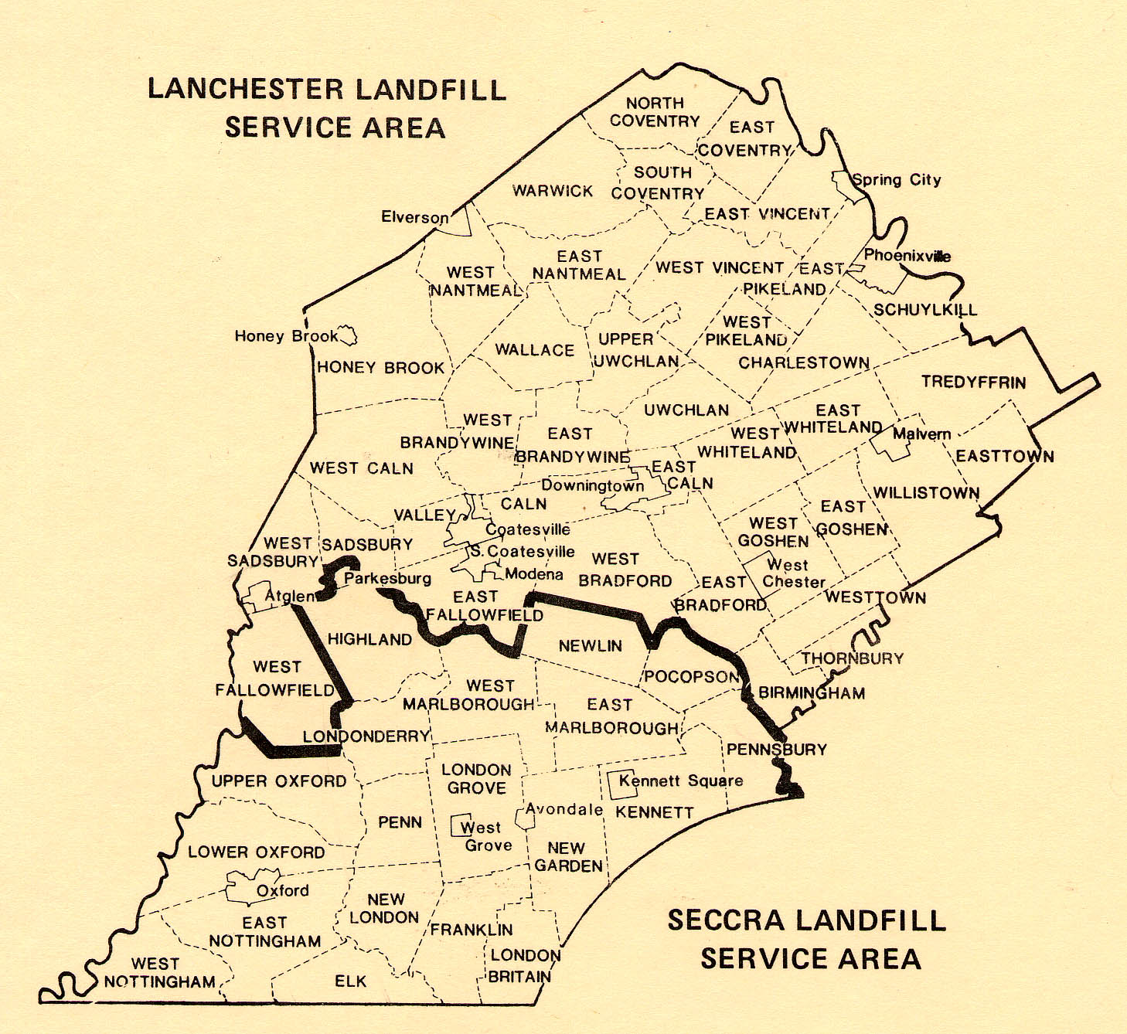
Notes:
Chester County’s Solid Waste Management Plan has two designated sites for disposal – The Southeastern Chester County Refuse Authority’s Landfill and CCSWA’s Lanchester Landfill.

Slide 4
Chester County Solid Waste Authority
Service Area Population
49 Municipalities
Population Pennsylvania 2010: |  | 12,702,379 | 3%
Population Chester County 2010: |  | 498,886 | 15%
Population | Population
2000 | 2010 | Increase | % Increase
352,272 | 398,123 | 39,374 | 11%
%Chester County in Service Area by population: |  |  | 80%
Source: U.S. Census Bureau - Prepared by: Pennsylvania State Data Center
Notes:
Last (2010) census figures.

Slide 5
2008 | 365,706
2009 | 341,009
2010 | 326,634
2011 | 331,889
2012 | 318,832
2013 | 315,093
2014 | 307,147
2015 | 294,754
2016 | 288,094
2017 | 287,261
MSW Tons of Waste
Generated by Chester
County, PA by Year
Data is from the Pennsylvania Department of Environmental Protection
Notes:
The amount of Municipal Solid Waste generated by all of Chester County had been generally decreasing since 2006. Why is this happening? It is not all due to the recession. I will discuss in the following slides some of reasons for the reduction in the disposal of municipal solid waste in Chester County.

Slide 6
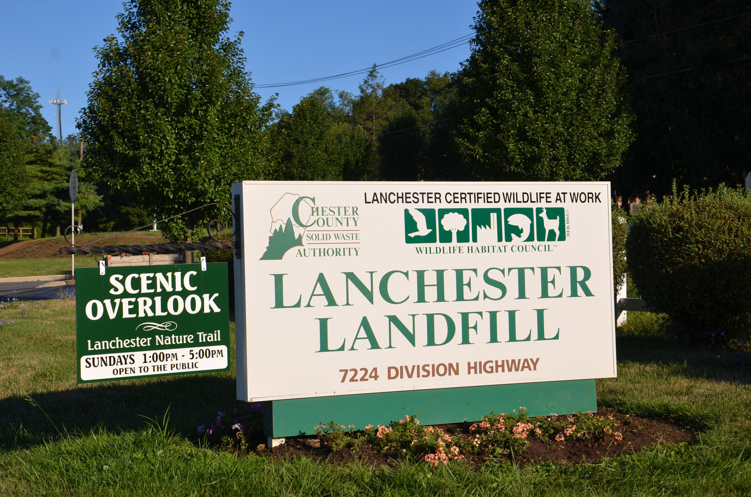
Notes:
Entrance sign.

Slide 7
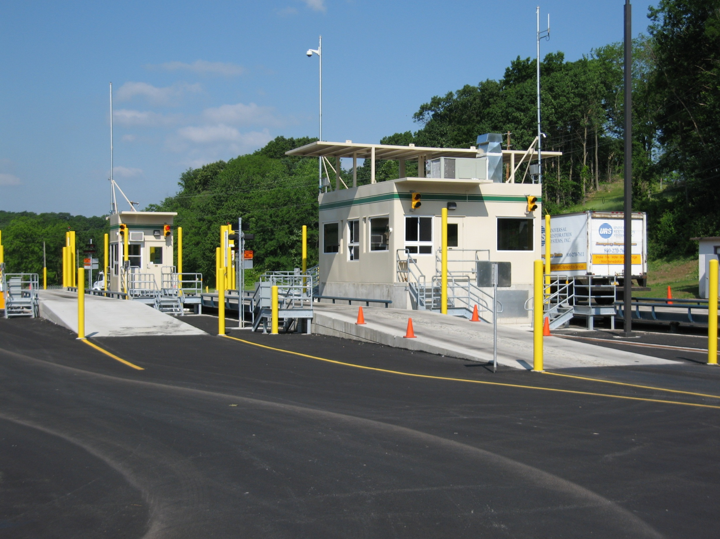
Notes:
Scale house – all vehicles are weighed in and out. CCSWA’s main source of revenue is tipping fees charged on the weight of waste disposed of in the Lanchester Landfill.

Slide 8
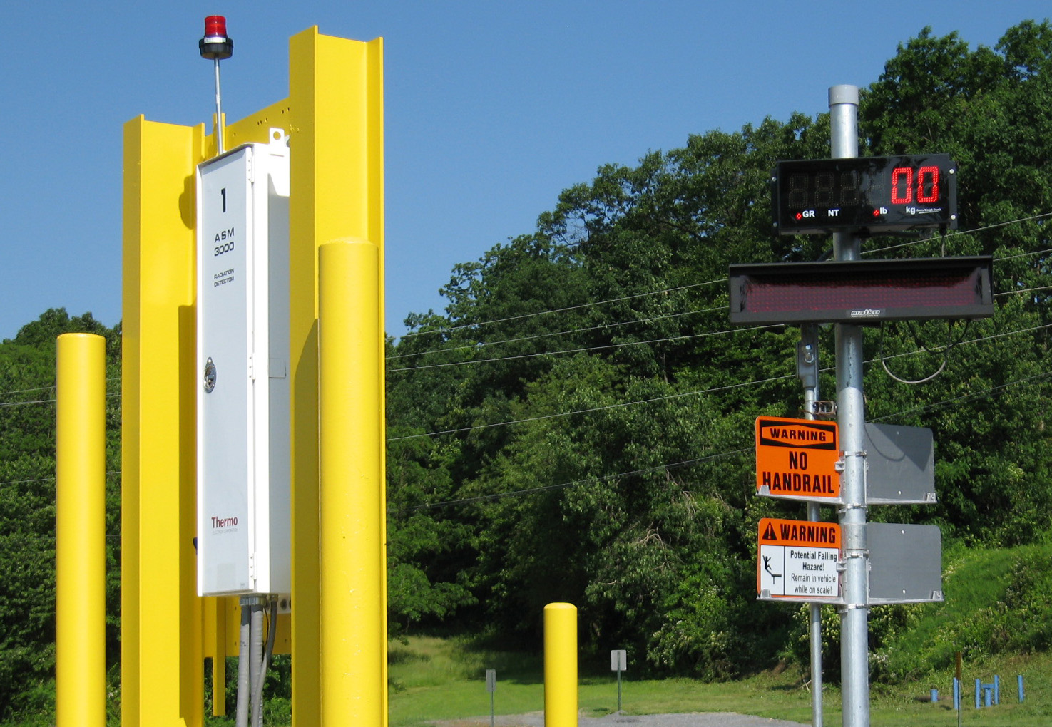
Notes:
Radiation Detector.

Slide 9
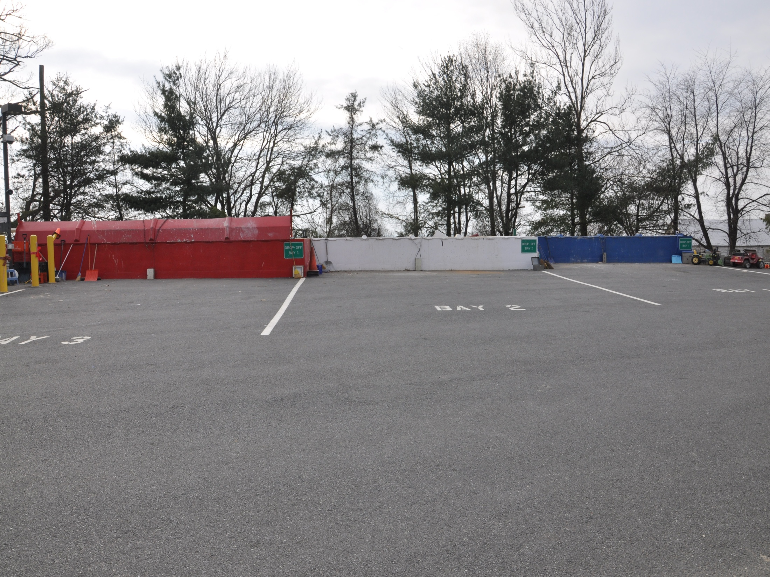
Notes:
Small Load Facility disposal area.

Slide 10
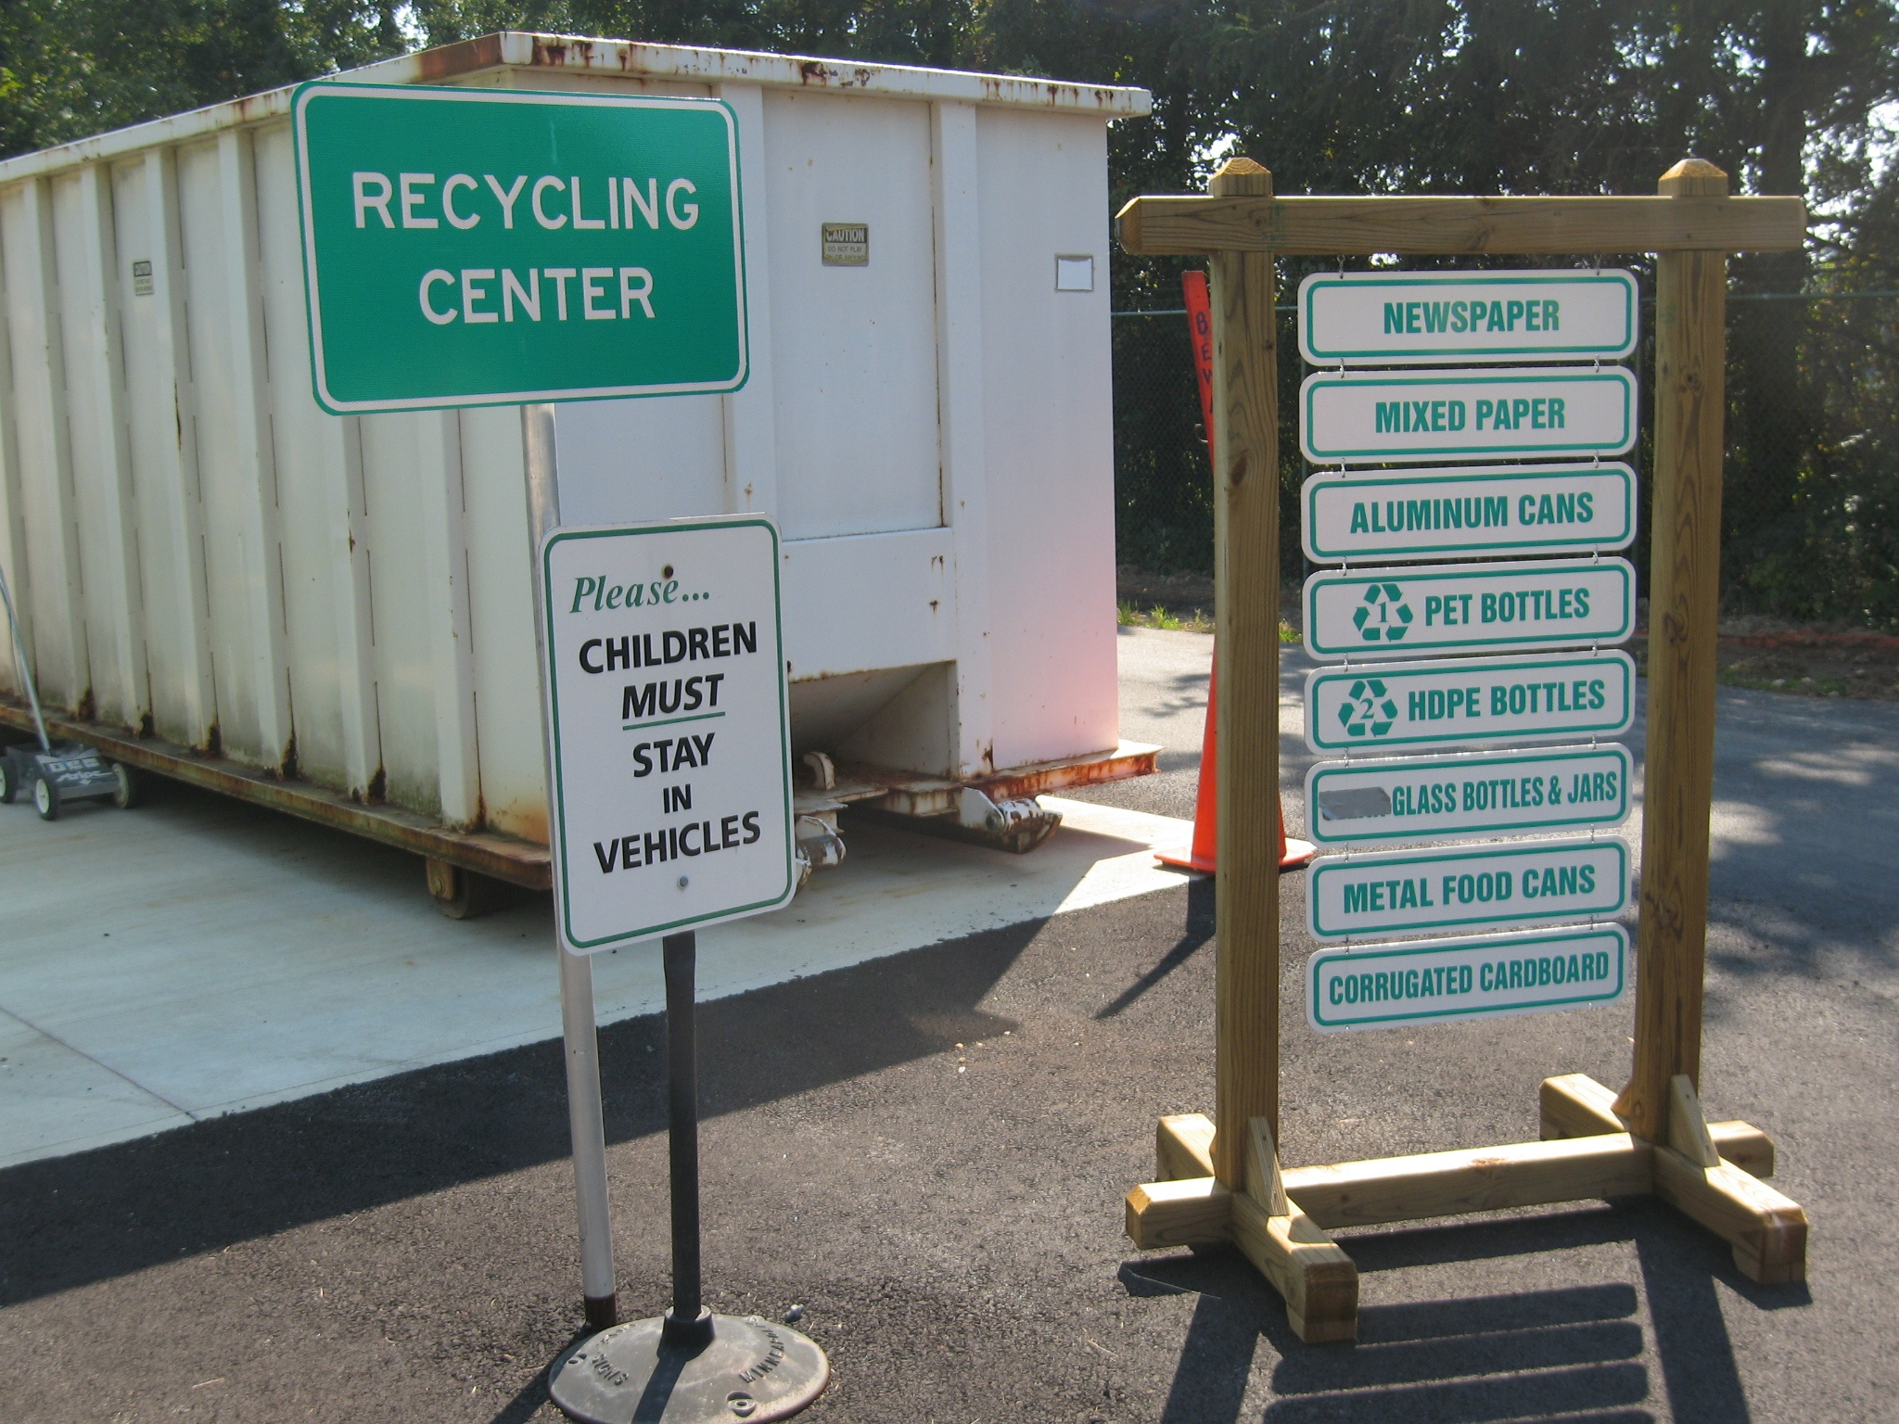
Notes:
We recycle these items and many more

Slide 11
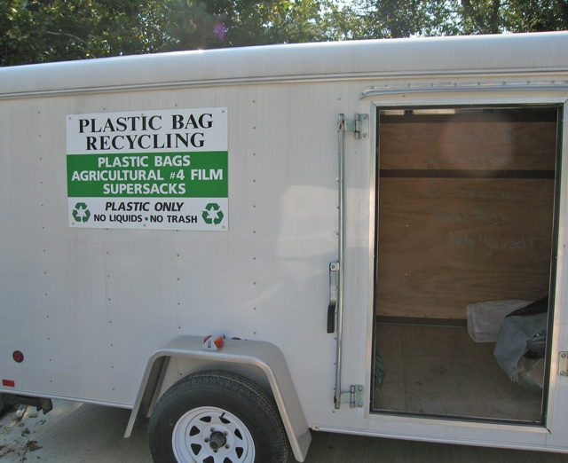
Notes:
Plastic bag recycling trailer

Slide 12
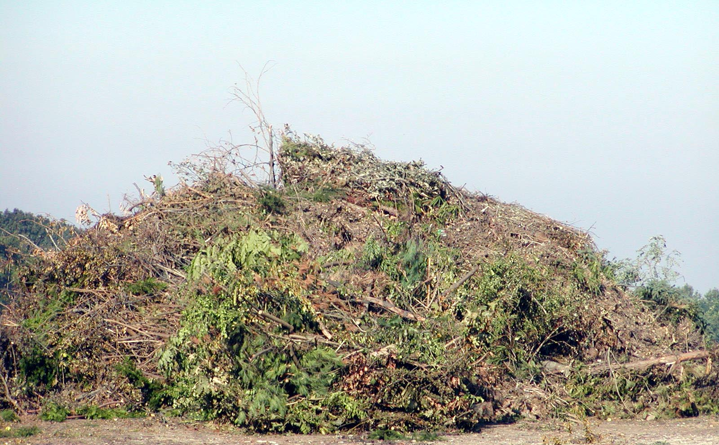
Notes:
Brush

Slide 13
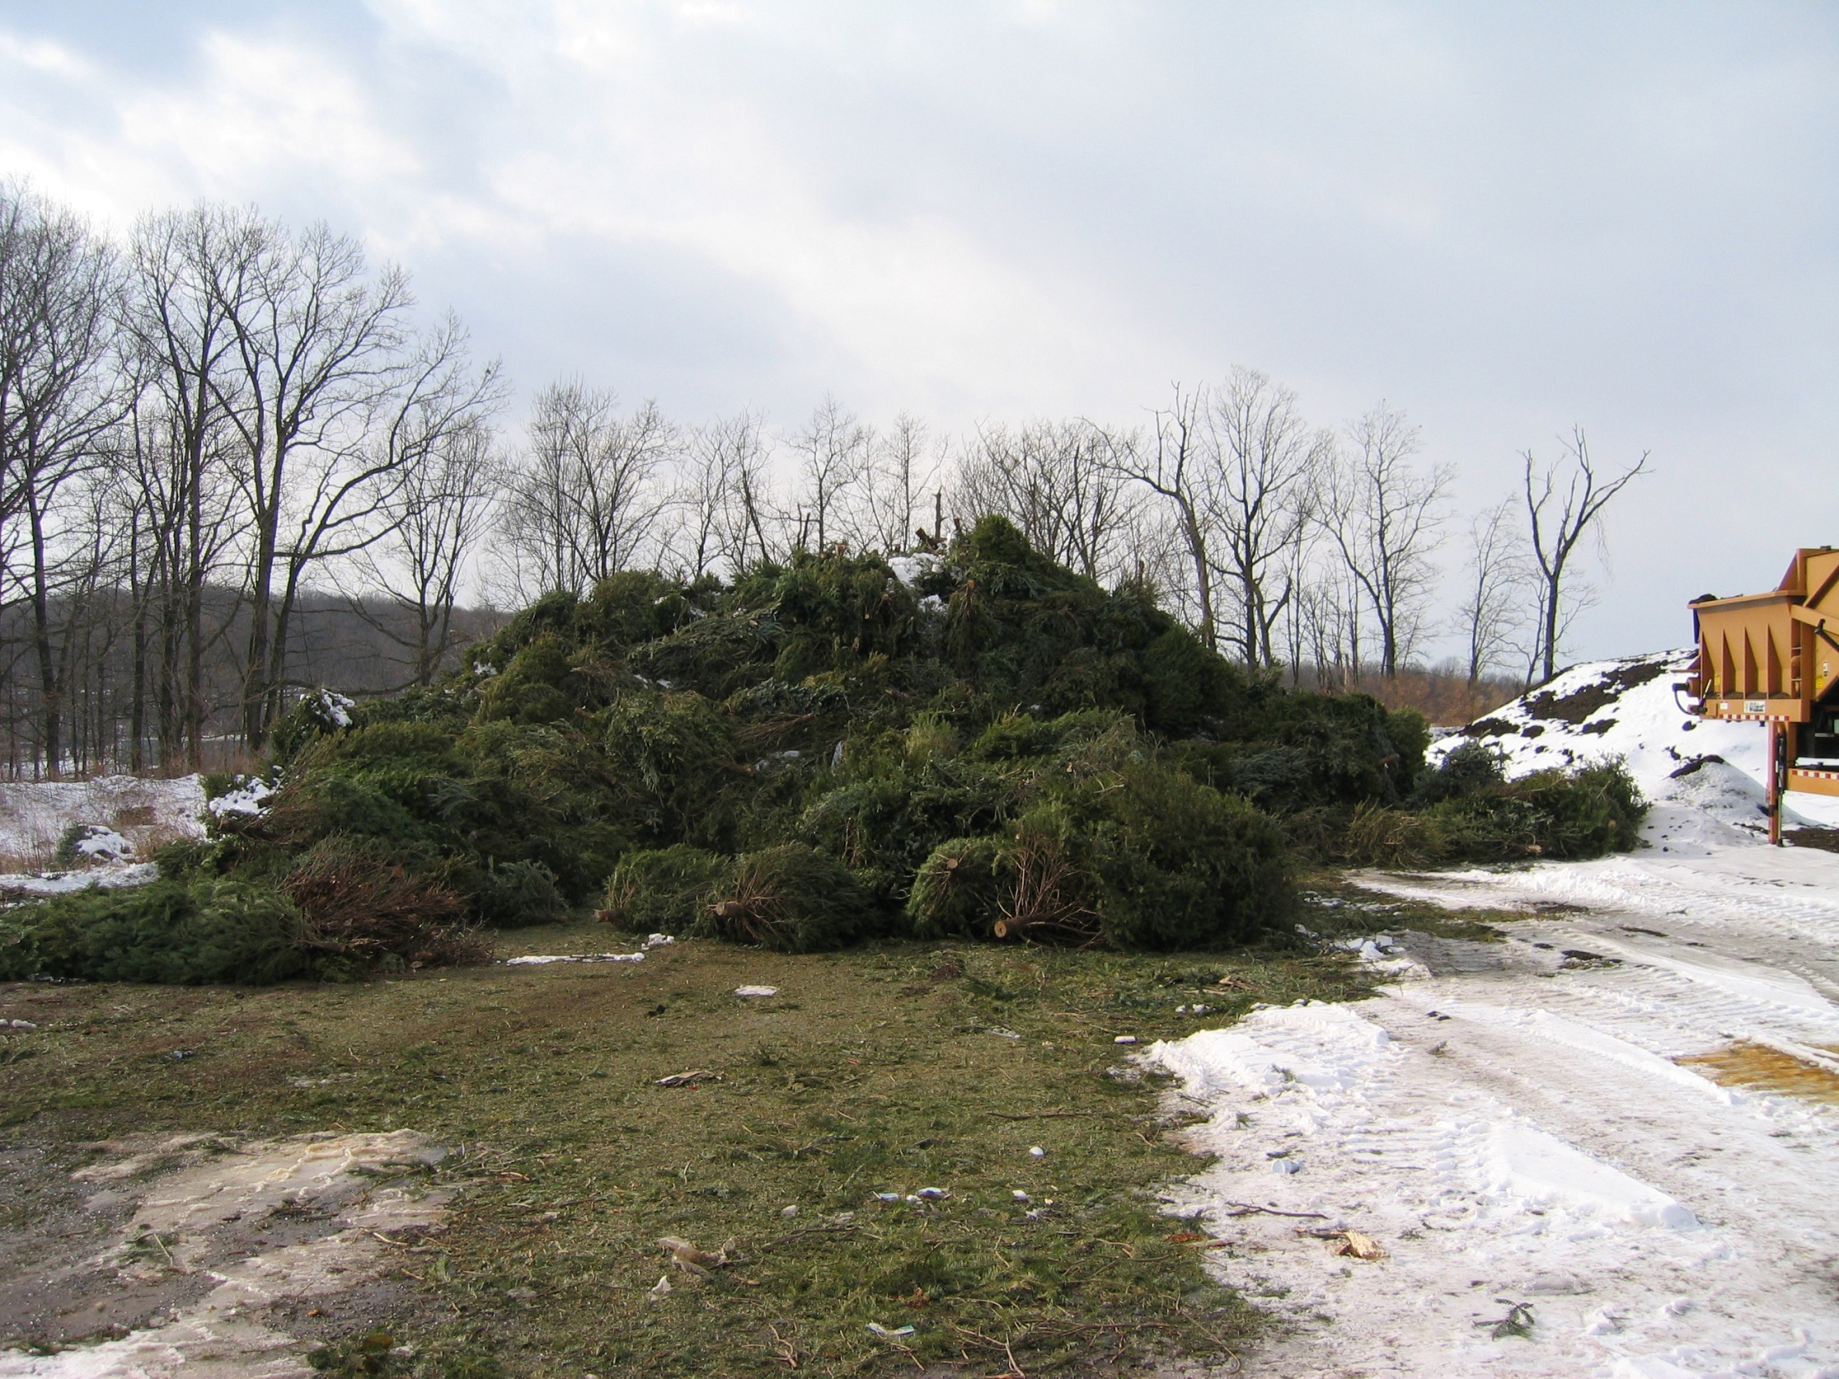
Notes:
Christmas trees

Slide 14
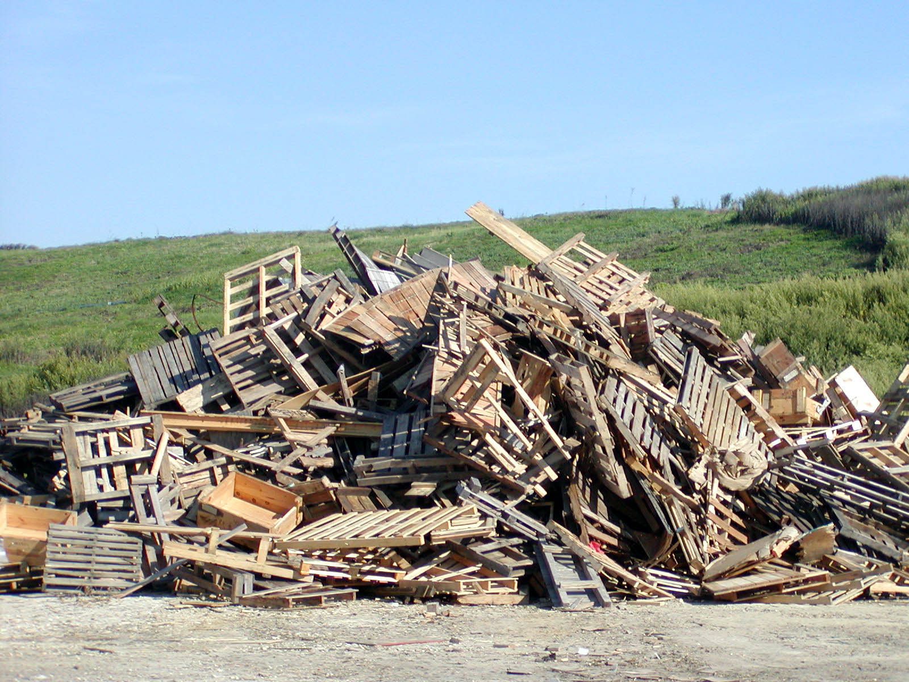
Notes:
Wood waste

Slide 15
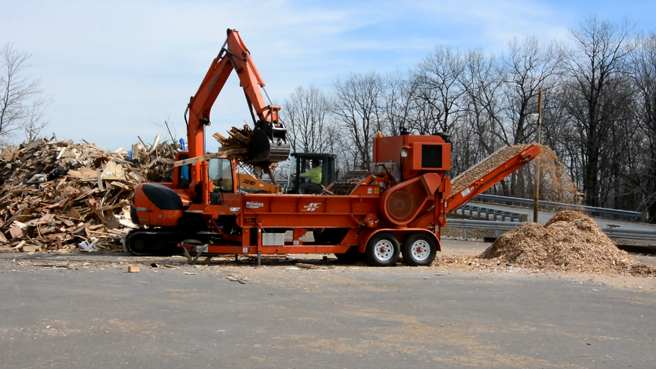
Notes:
Wood grinder video.

Slide 16
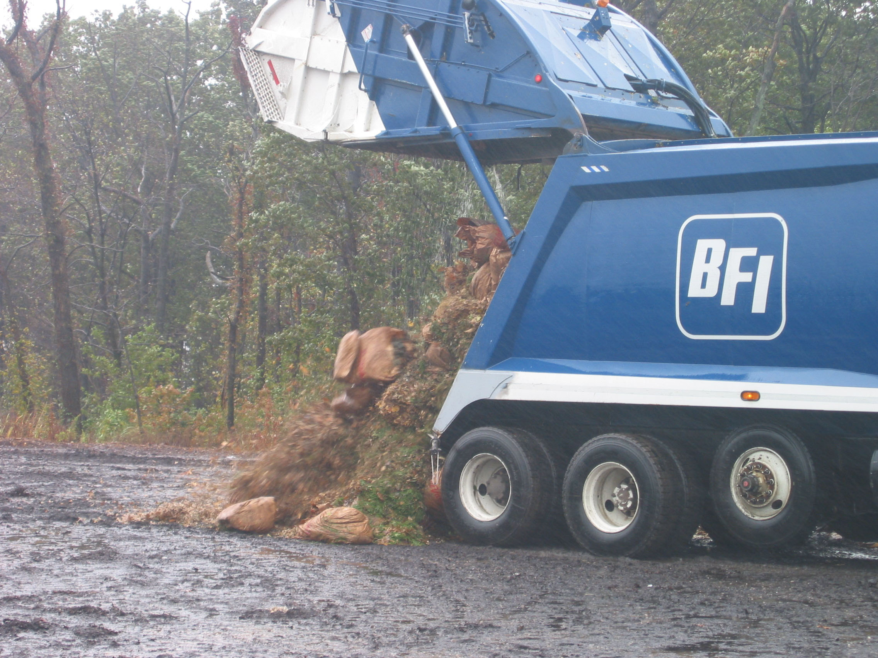
Notes:
We compost leaves

Slide 17
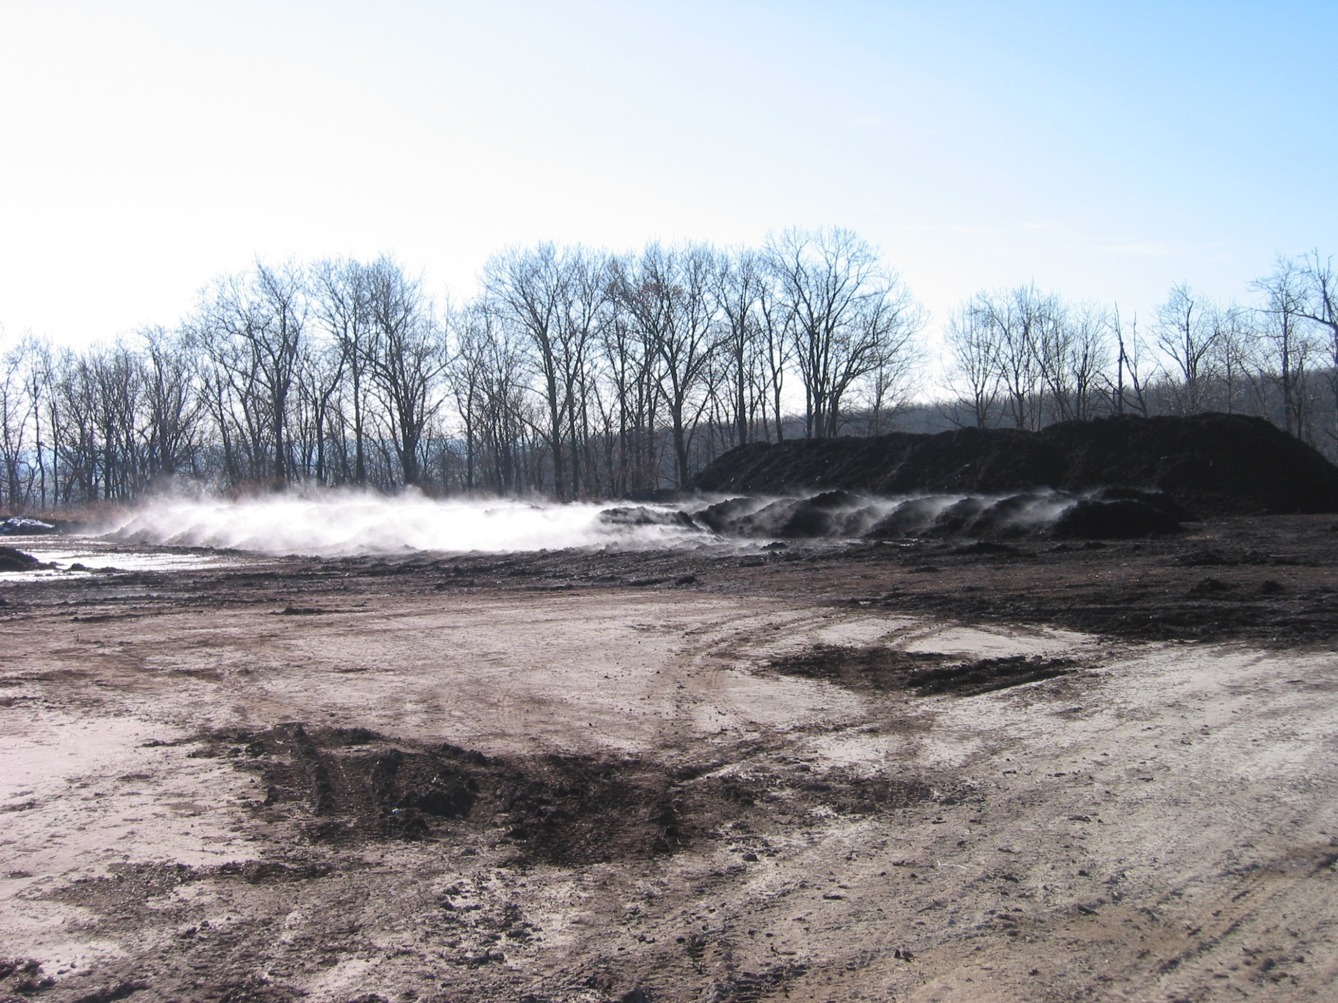
Notes:
Leaves in windrow just after turning on a cold day

Slide 18
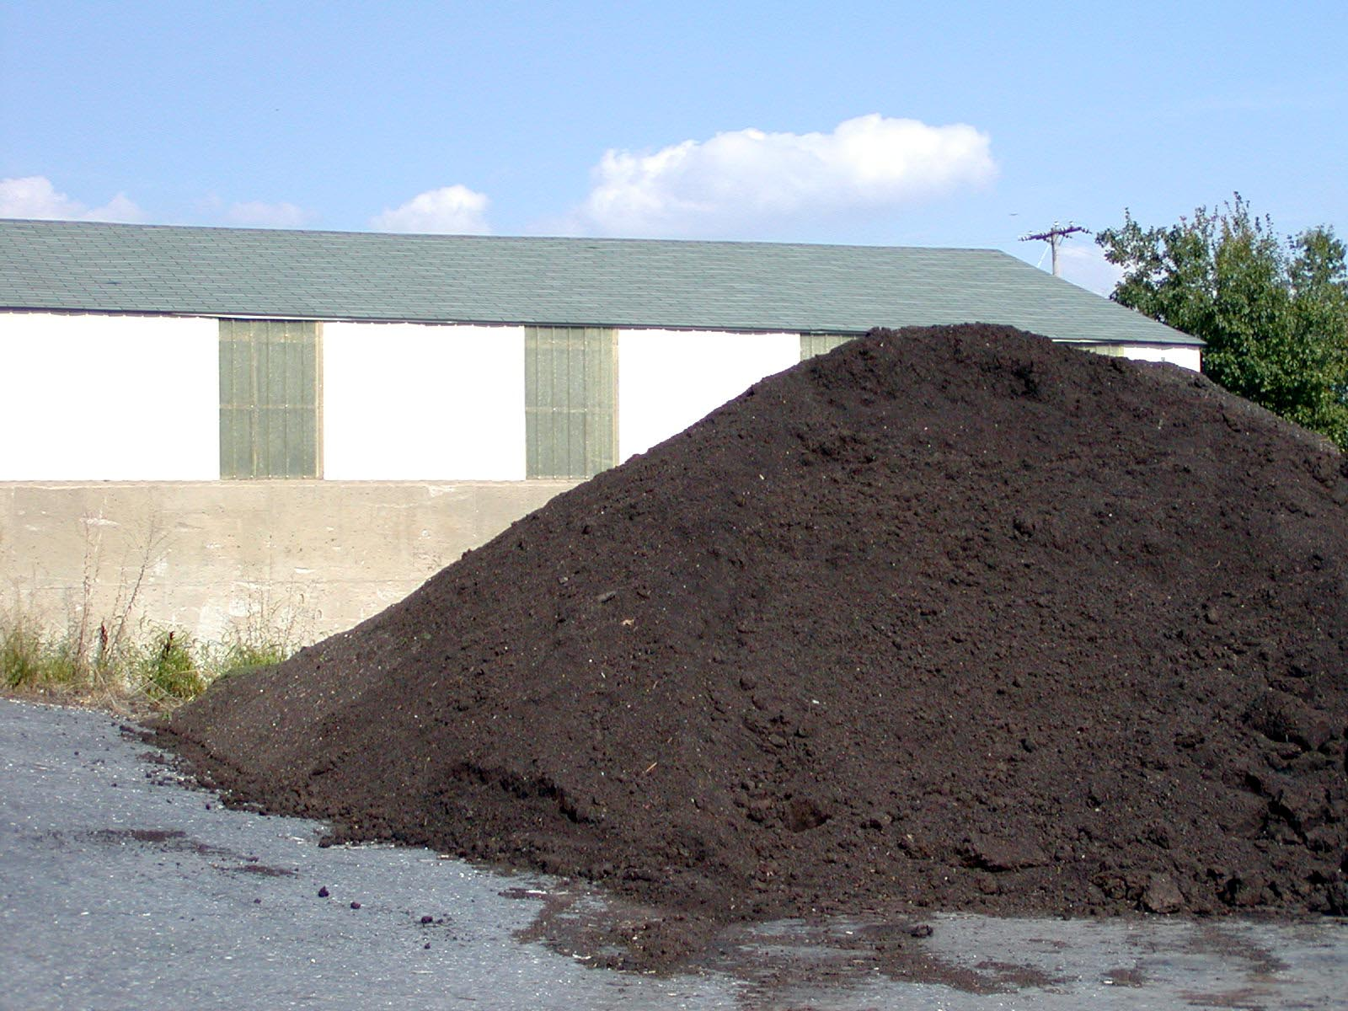
Notes:
Composted leaves after screening – ready for sale.

Slide 19
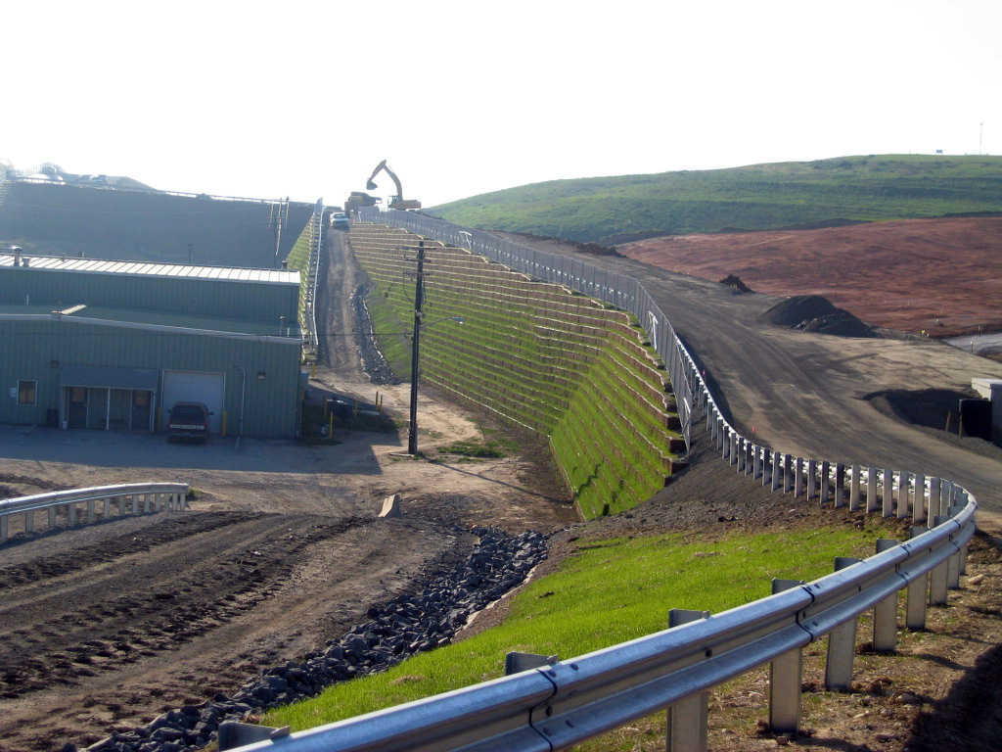
Notes:
Maintenance building and the west end of Area D’s Mechanically Stabilized Earth (MSE) Wall

Slide 20
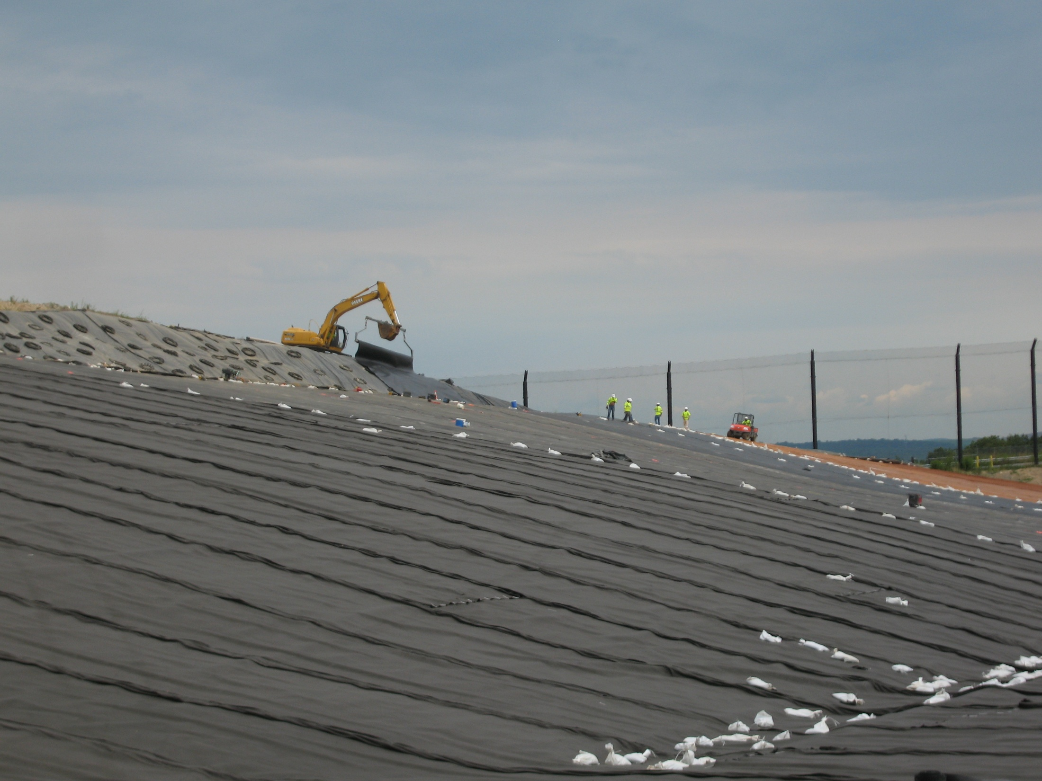
Notes:
Liner system being deployed over a portion of the Municipal Site Landfill.

Slide 21
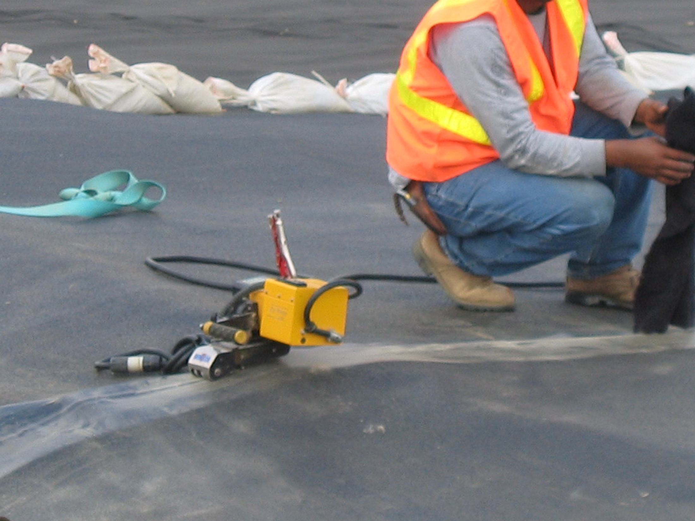
Notes:
Welding the High Density Polyethylene sheets together with a wedge welder

Slide 22
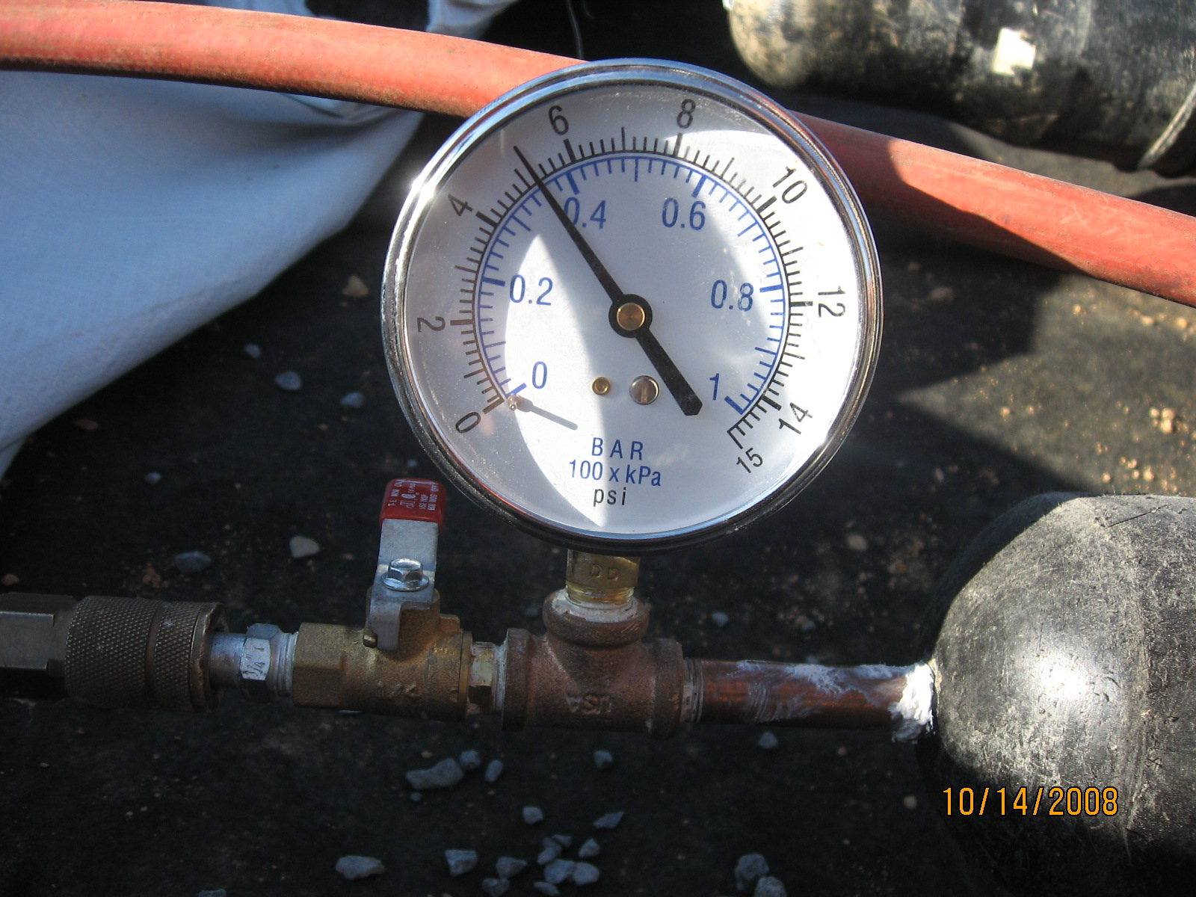
Notes:
Testing the seams with air pressure

Slide 23
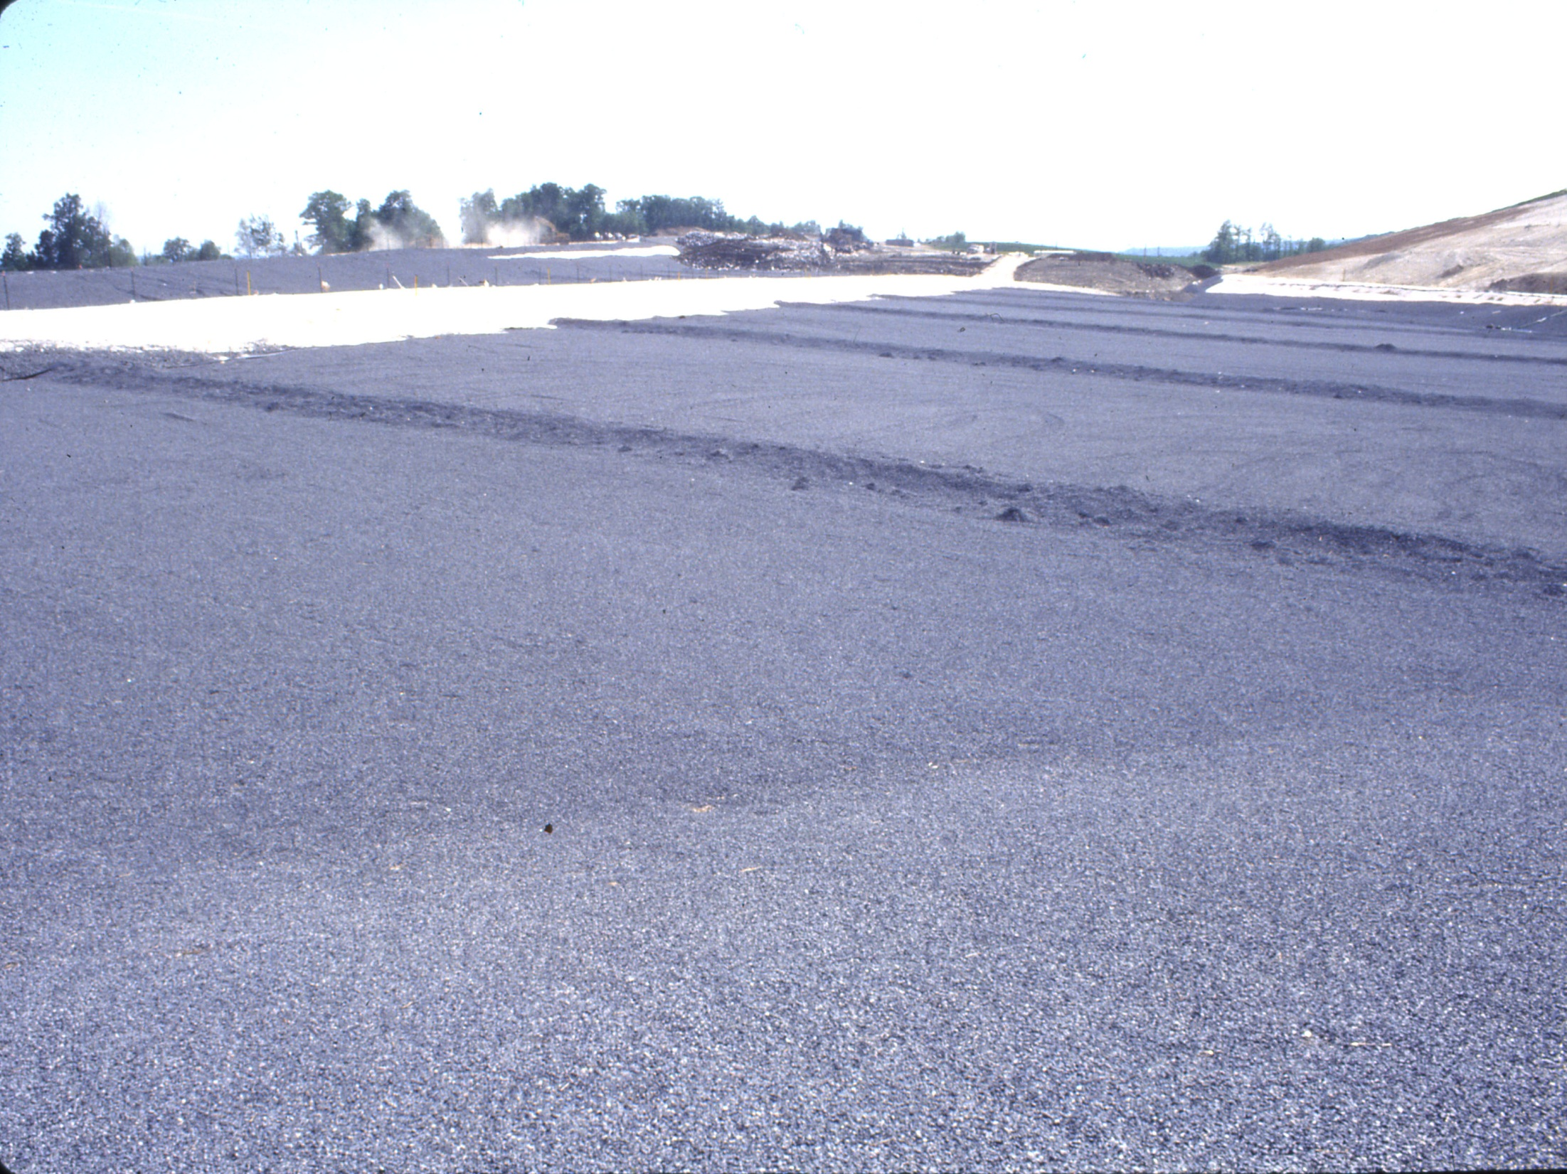
Notes:
Looking at the top of 18 inches of crushed rock on top of a portion of the Area D Liner System.

Slide 24
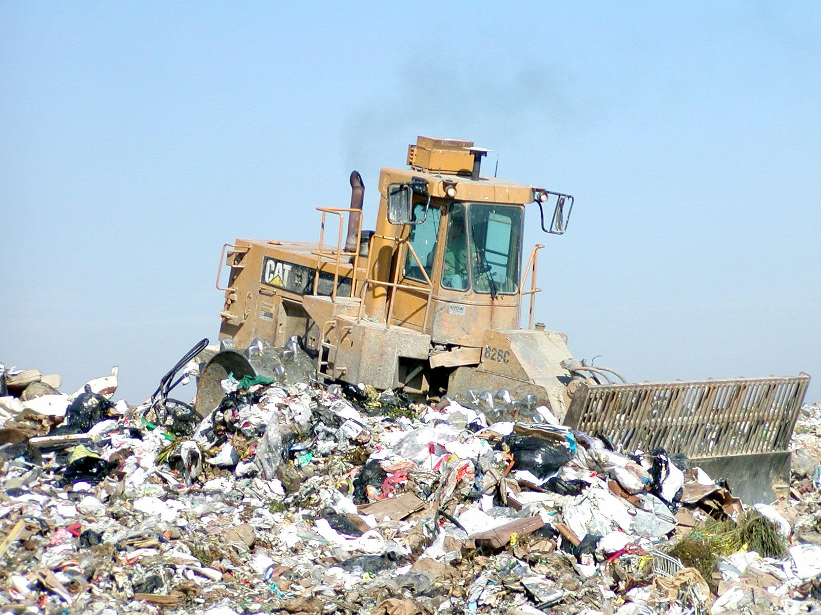
Notes:
Landfill Compactor at the working face.

Slide 25
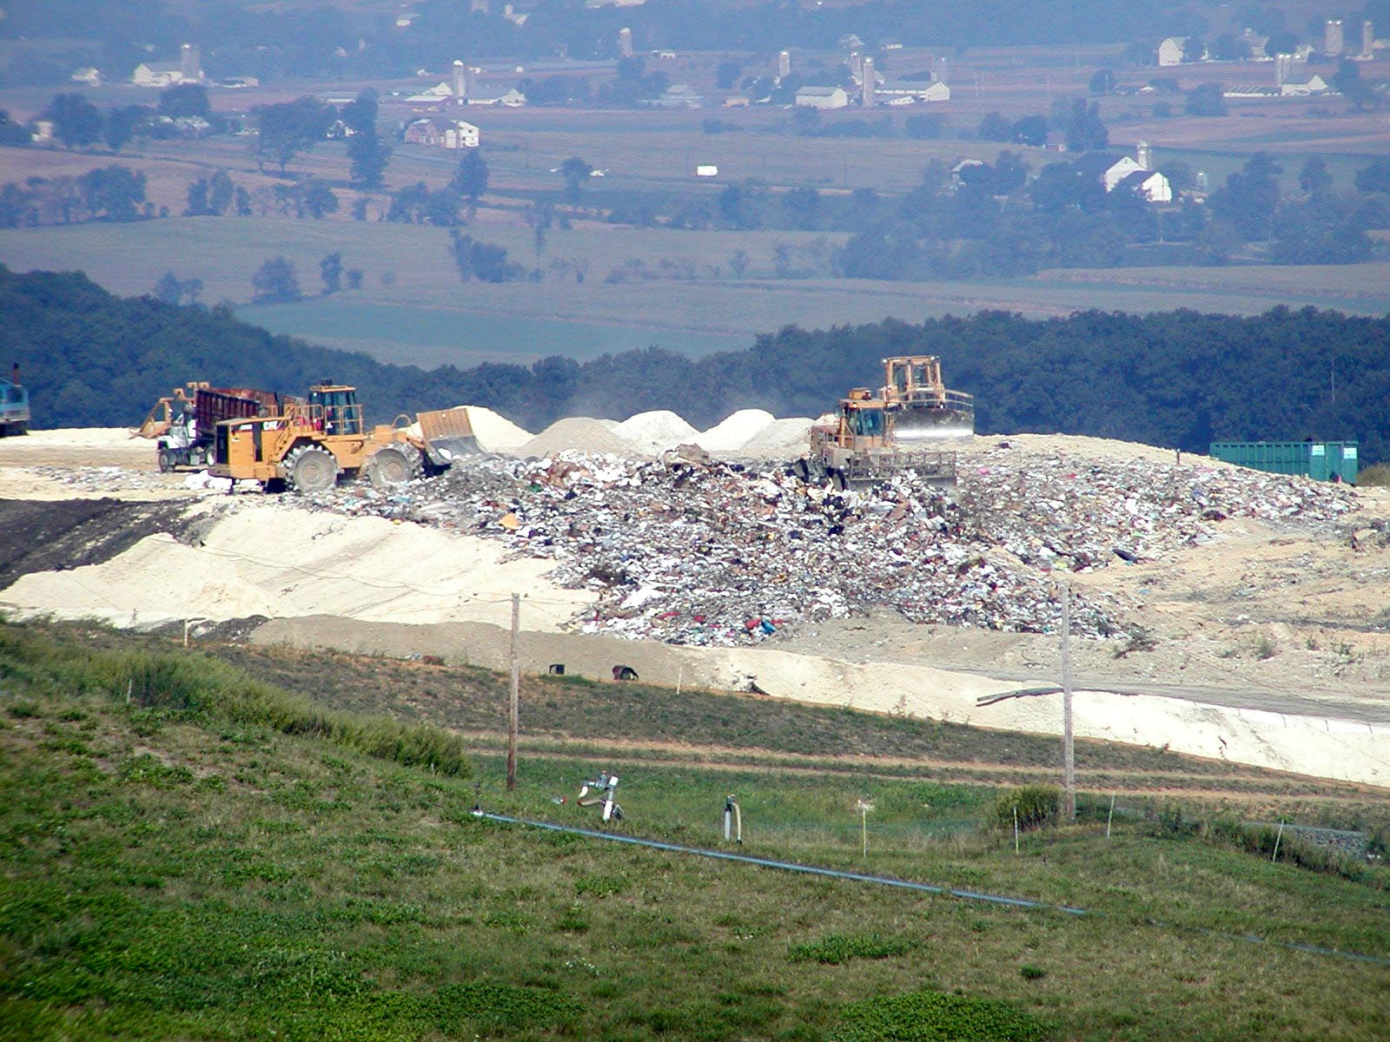
Notes:
On a typical day we work in about a half acre area, piles of soil are staged for six inches of daily cover on portions of the day’s work area

Slide 26
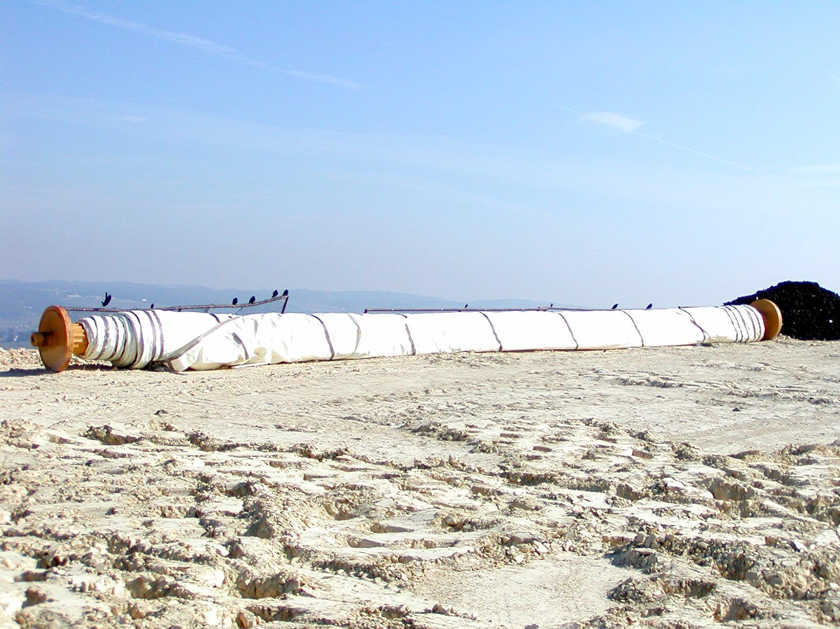
Notes:
Other parts of the day’s work area are covered with approved alternate daily cover such as the tarps in this slide, ash, contaminated soil or spray on products

Slide 27
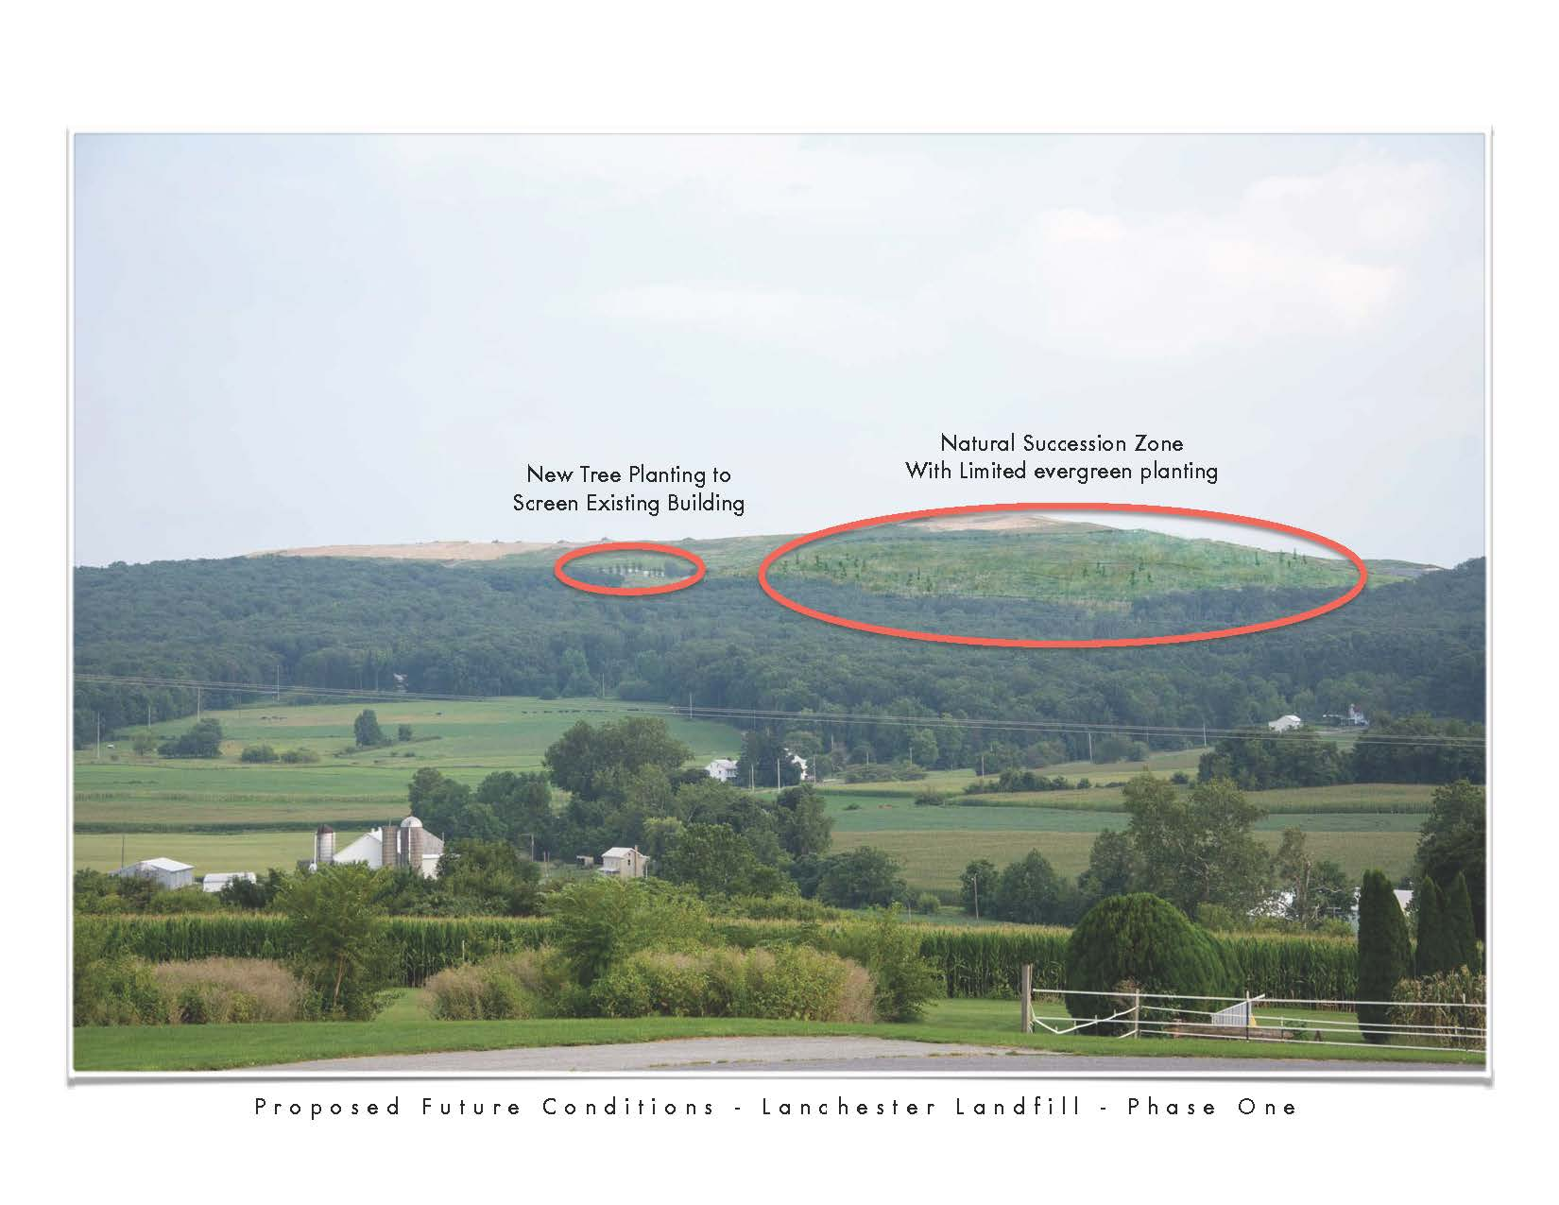
Notes:
We have submitted an application for a demonstration permit for natural selection and limited evergreen planting on the north slope of the landfill

Slide 28
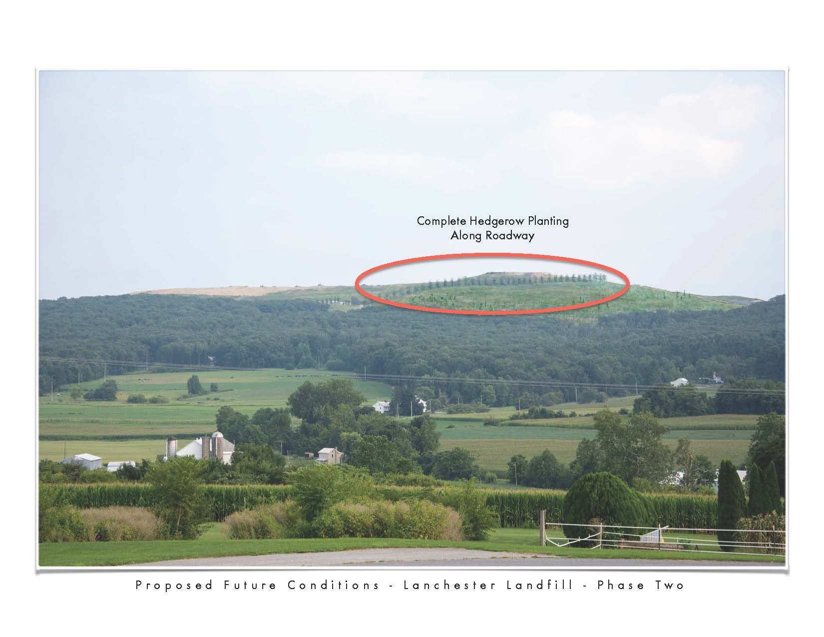
Notes:
Phase II would include a hedgerow planting along the access road.

Slide 29
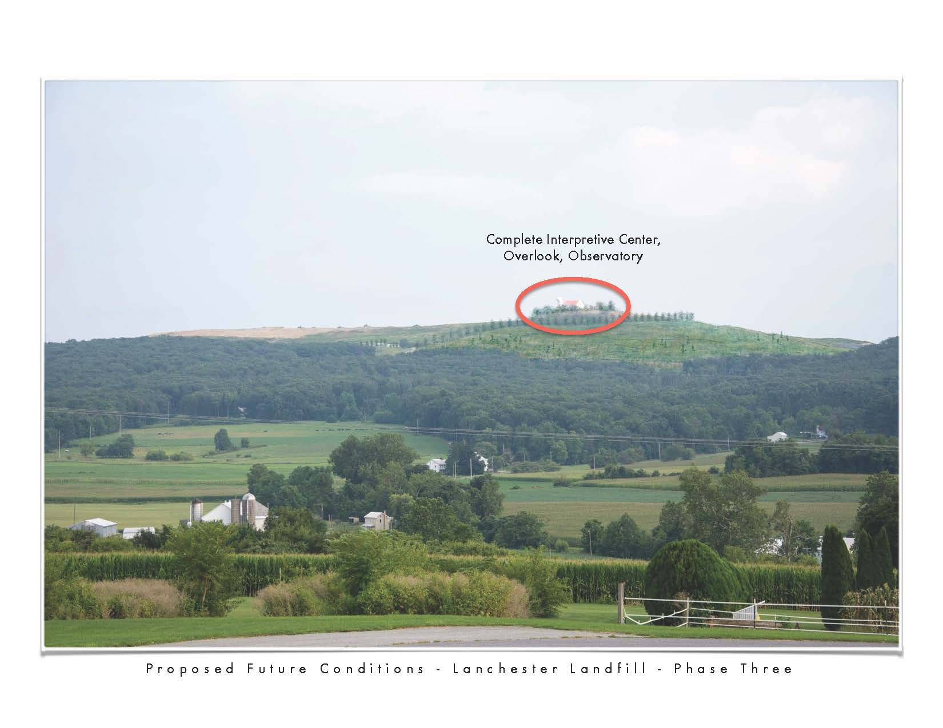
Notes:
Phase III may include an Interpretive Center, Overlook, Observatory and additional plantings.

Slide 30
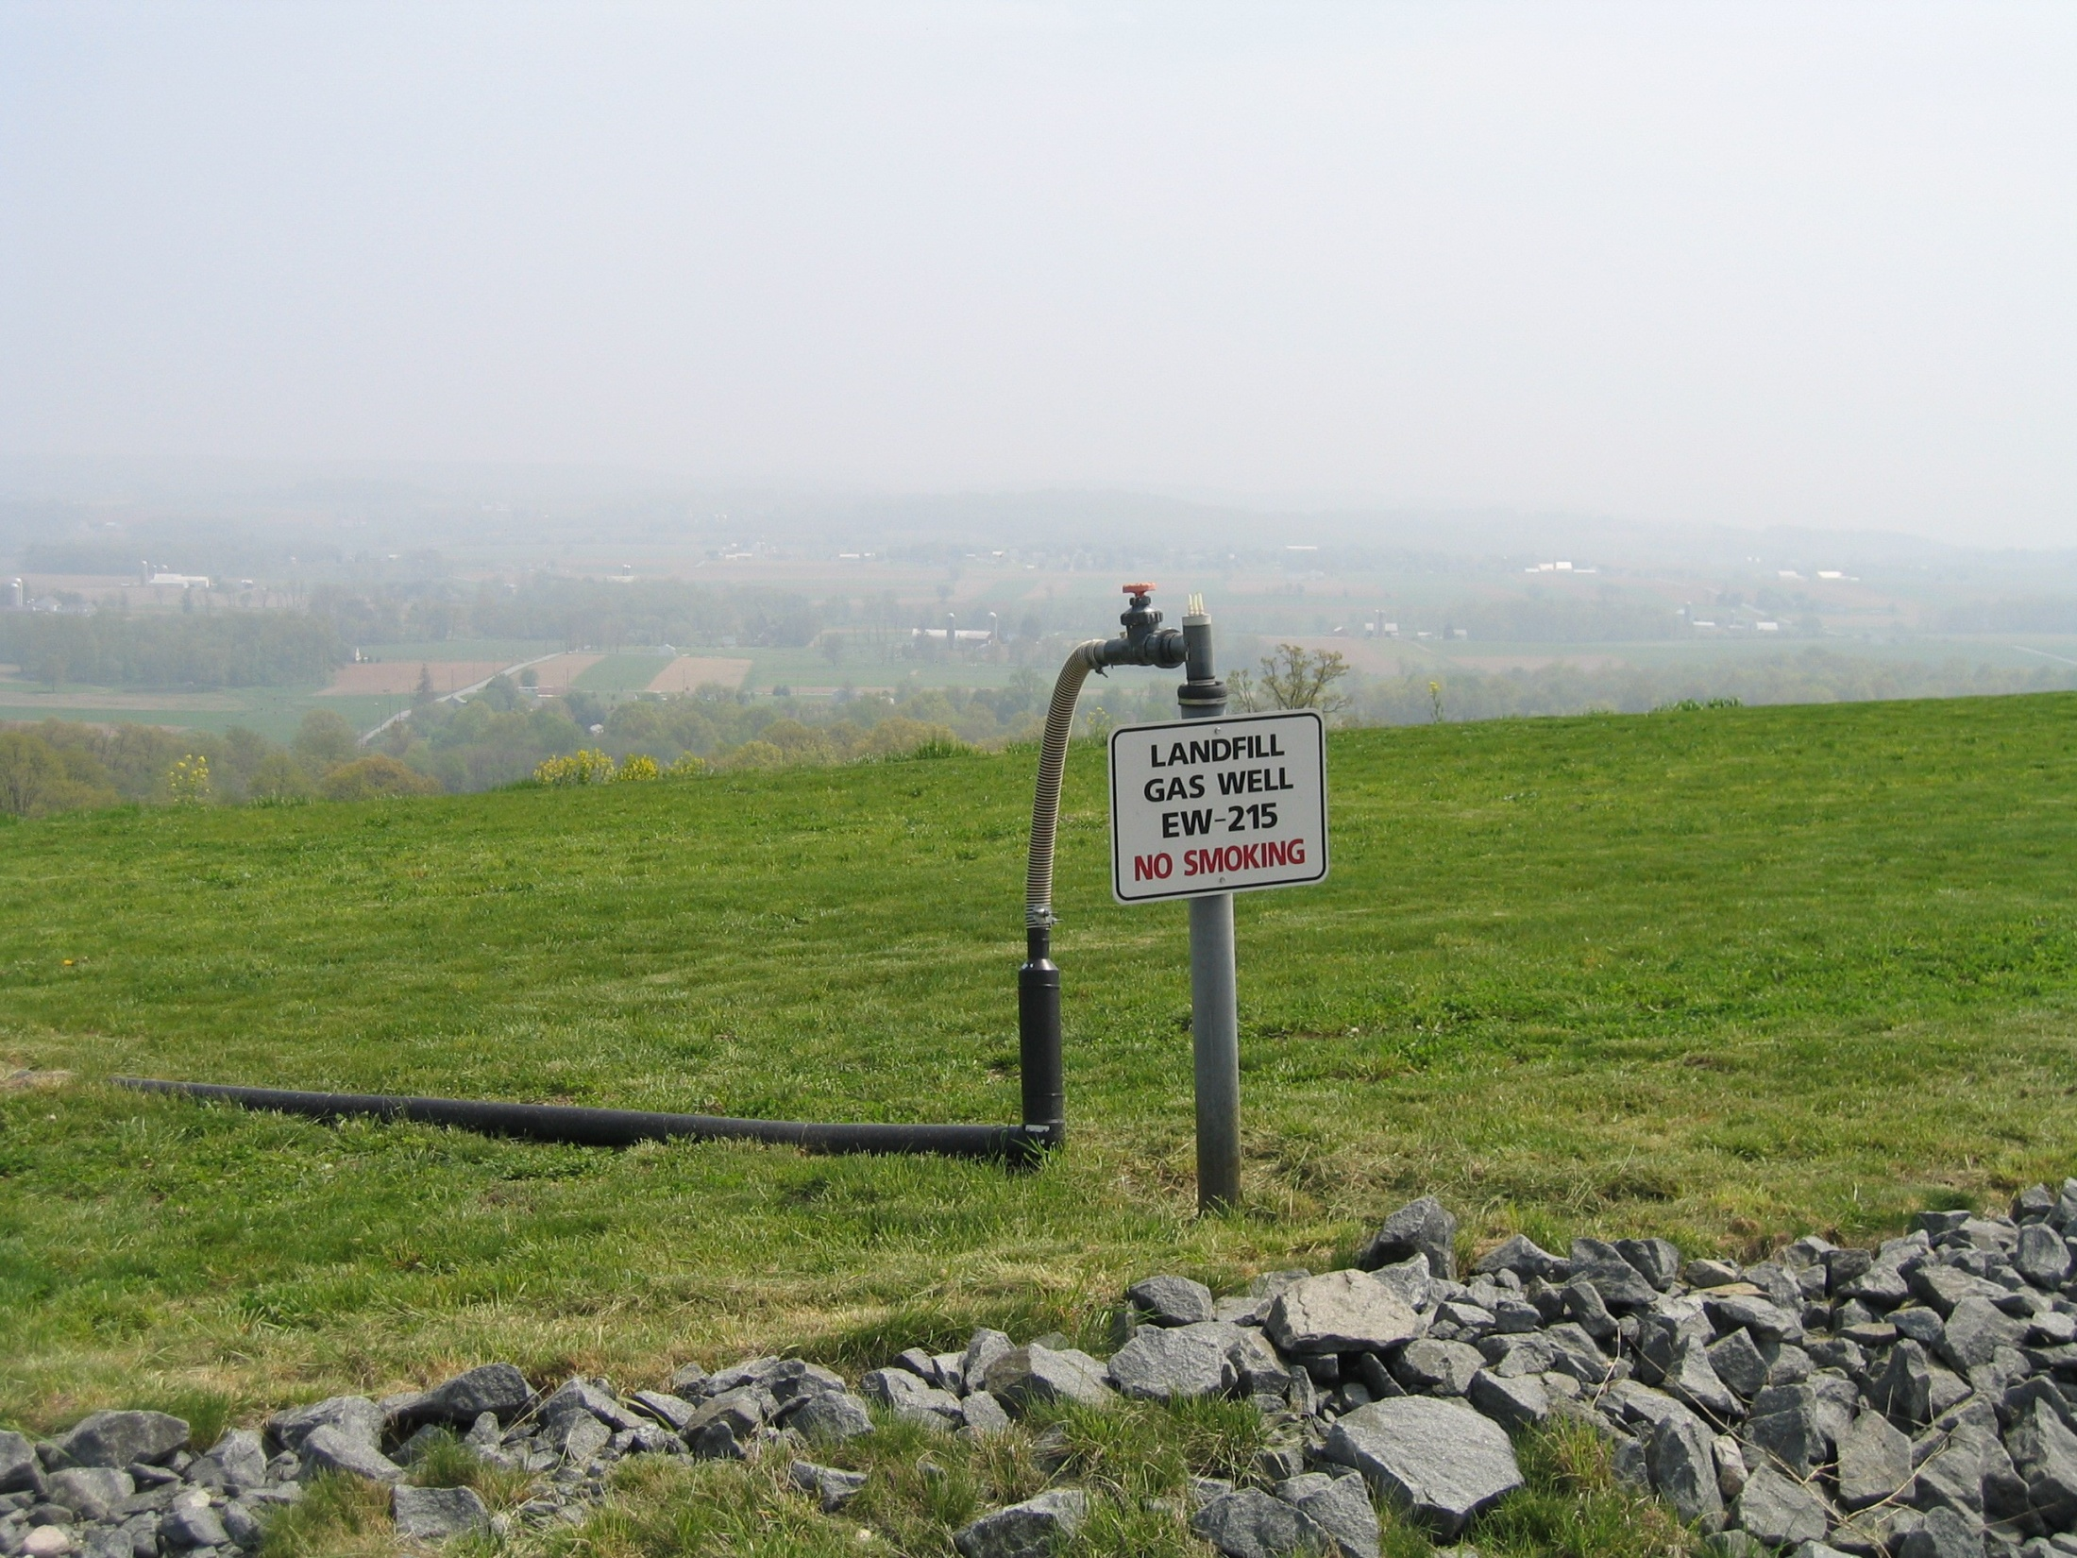
Notes:
One of our about 180 landfill gas extraction wells

Slide 31
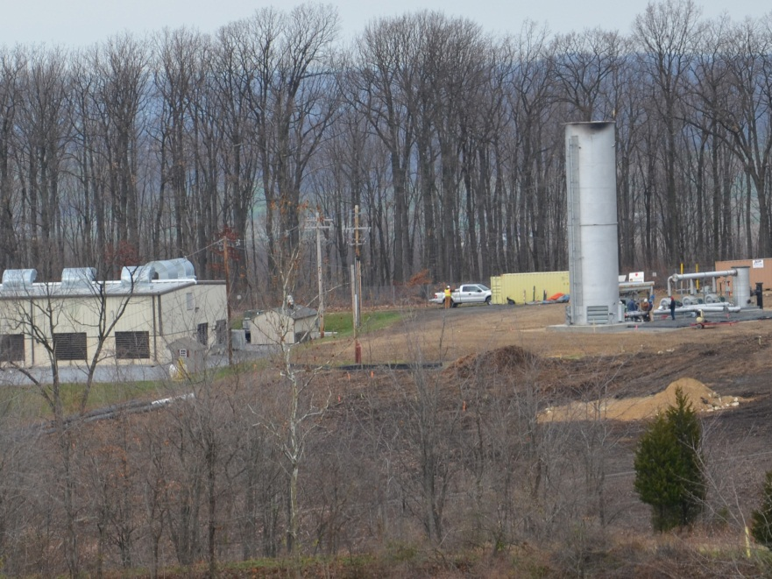
Notes:
At a minimum we must burn the landfill gas in the shrouded flare on the right side of the picture which assures at least 98% destruction of the methane portion. The building at the left is the back of the Granger Energy Building.

Slide 32
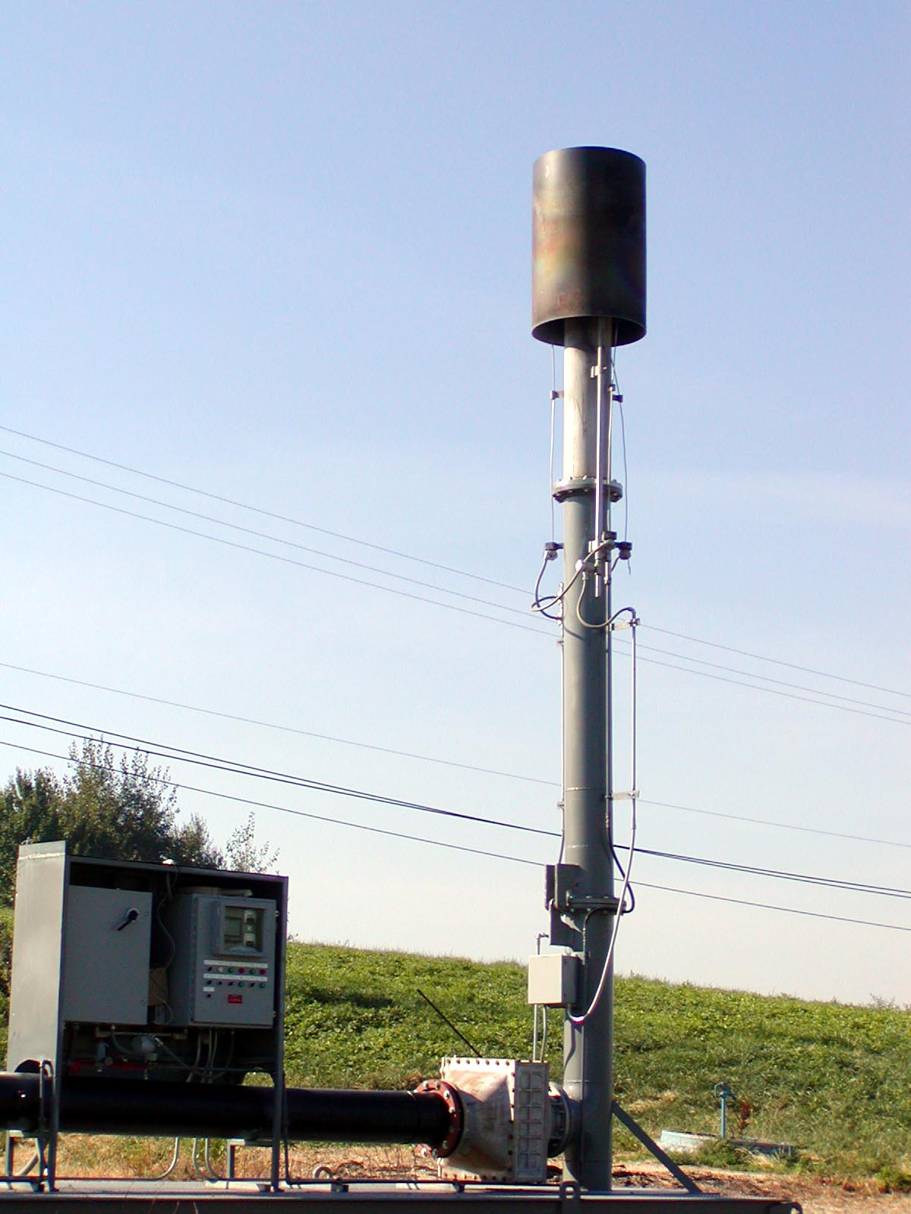
Notes:
Our backup utility flare

Slide 33

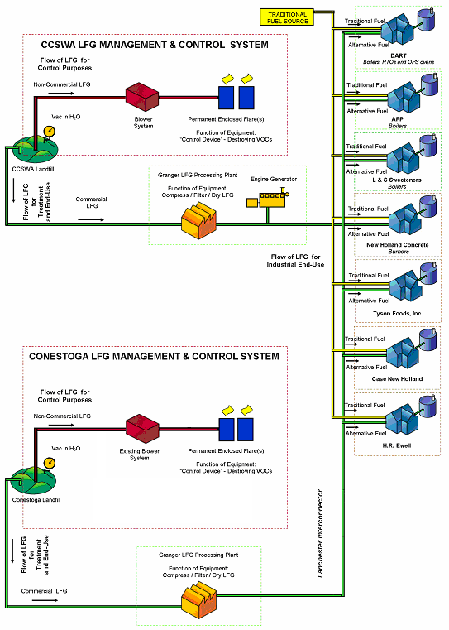
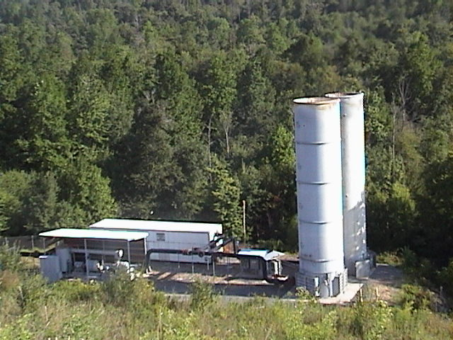
Conestoga LFG Project
DEVELOPMENT PLAN
Notes:
Conestoga Landfill’s gas is also managed with Lanchester’s by Granger Energy. They are currently generating 3MW of electricity at Lanchester and sending the remaining gas down a 13 mile pipeline to seven customers in the New Holland area.

Slide 34
Landfill Gas from the Lanchester
Landfill is Equivalent to:
Electrical use of 64,800 homes
Planting 282,200 acres of trees
Removing emissions of 208,800 cars
Offsetting the use of 4,800 rail cars of coal or preventing the use if 220,800 barrels of oil per year

Slide 35
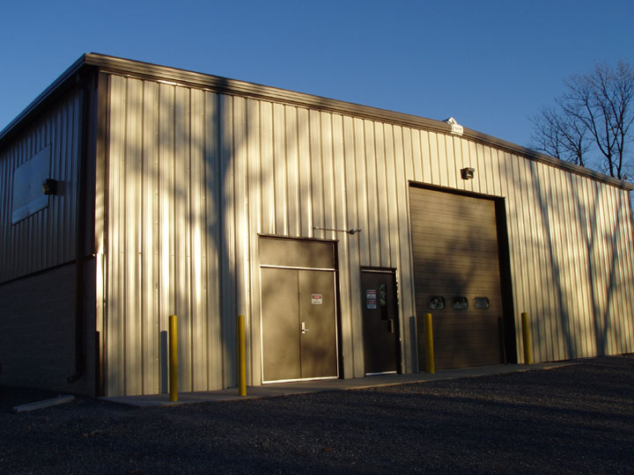
Notes:
The west side of the Granger building

Slide 36
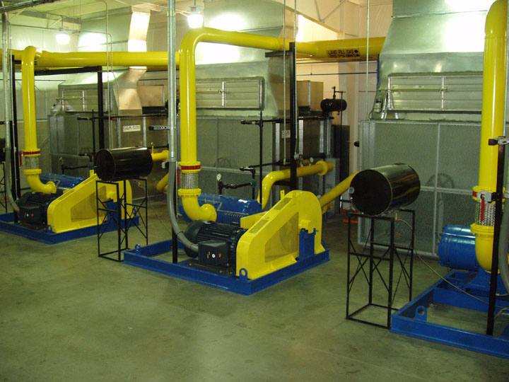
Notes:
View of three of Granger’s five compressors that provide the vacuum on the Lanchester Landfill to capture the gas and the power to push the gas down the pipeline.

Slide 37
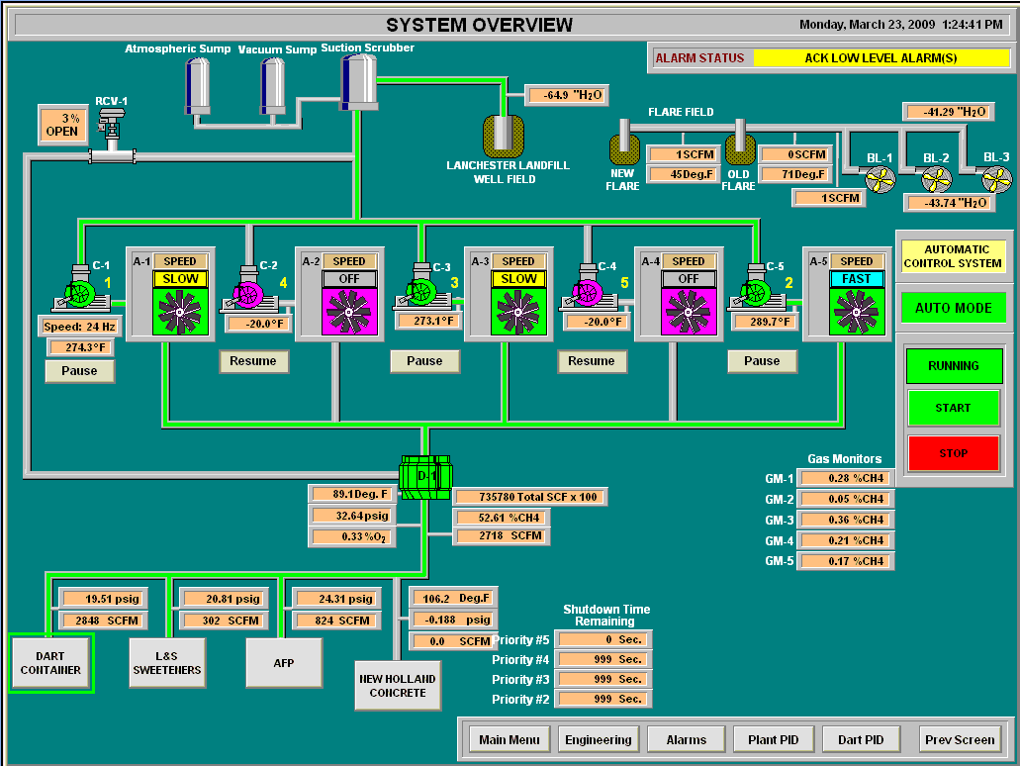
Plant Control Station
Notes:
Picture of Granger’s Plant Control System

Slide 38
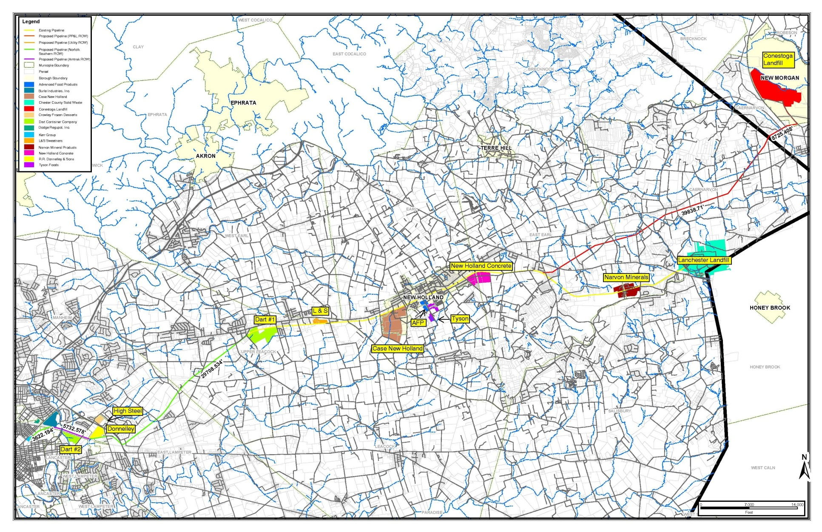
Pipeline Information:
9 miles of 18 inch HDPE Pipe – rated at 75 psi
1 mile of 24 to 30 inch HDPE Pipe – vacuum (Landfill Interconnector)
Notes:
Map of Granger’s landfill gas project.

Slide 39
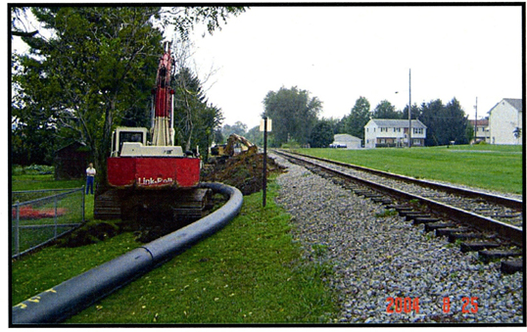
Lanchester/Conestoga LFG Project- Narvon, PA
PIPELINE – approximately 25 miles
16” and 18” SDR 11 & 21 HDPE pipe
Constructed by five independent pipeline contractors
Notes:
Pipeline during installation

Slide 40
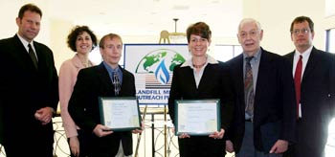
Notes:
Granger Energy and CCSWA receiving awards from the United States Environmental Protection Agency for Project of the year in 2005 for the direct use of Landfill Gas.

Slide 41


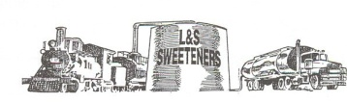



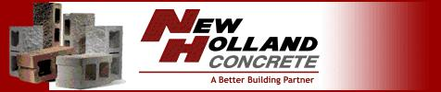
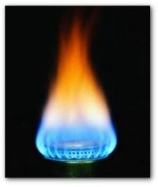
Customer Summary
Turbines 2 (5.0 MW each)
Internal Combustion
Engine/Generators 2 (1.6 MW each)
Boilers 25
Hot Oil Heaters 4
Ovens 4
Indirect Fired Heaters 3
Direct Fired Heaters 2
Remote Thermal Oxidizers 2
Process Water Heaters 2
Total to Date: 46 separate pieces of
combustion equipment

Slide 42
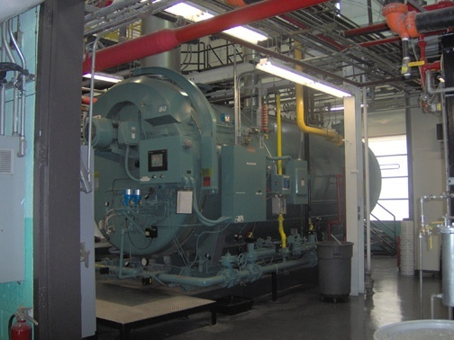
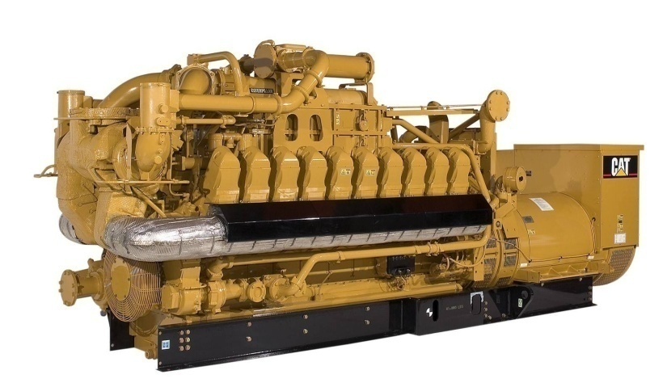
Future Customer Outlook:
Expansion of customers existing production facilities
2. Construction of customer-owned co-generation project currently underway – (2) additional engine generators
3. Installation of Granger –owned electrical generation equipment at second Granger LFG Processing Facility – (2) additional engine generators

Slide 43
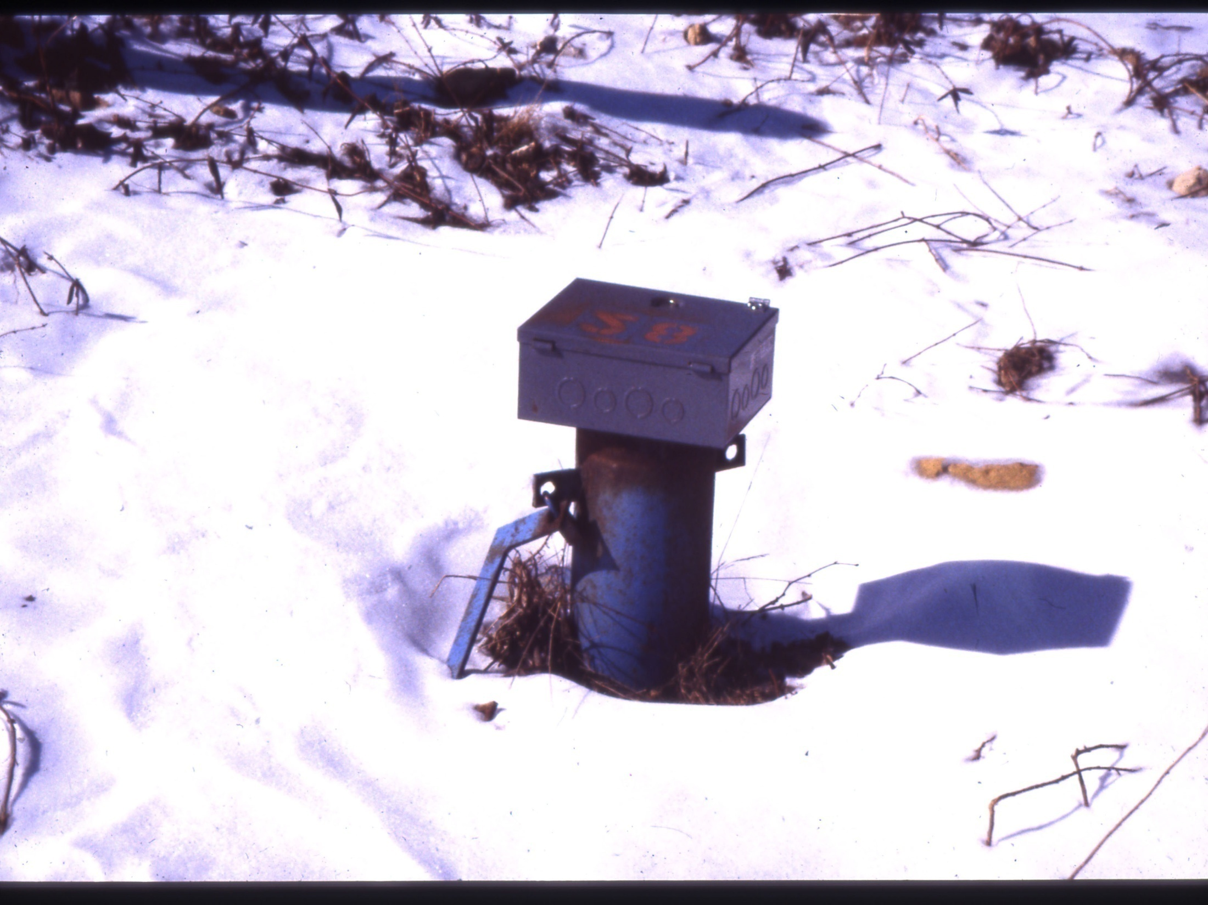
Notes:
One of Lanchester’s over 35 groundwater monitoring wells on site. CCSWA also samples quarterly over 30 groundwater wells of contiguous neighbors.

Slide 44
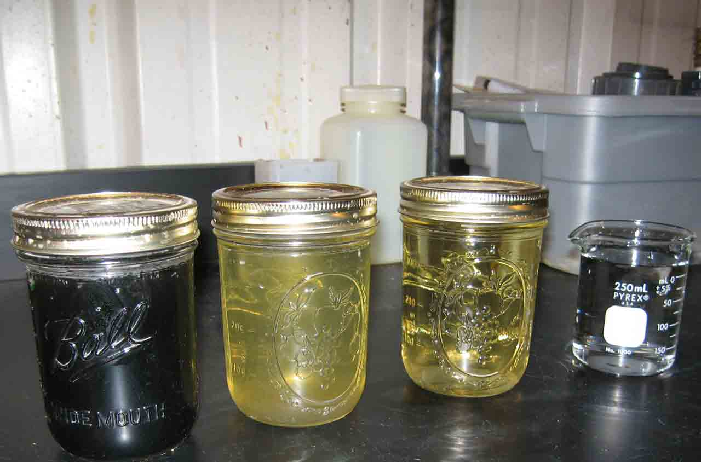
Notes:
Left is raw leachate (water that has percolated through the landfill), next is filtered, then after ultra-filtration and finally to the right after reverse osmosis.

Slide 45
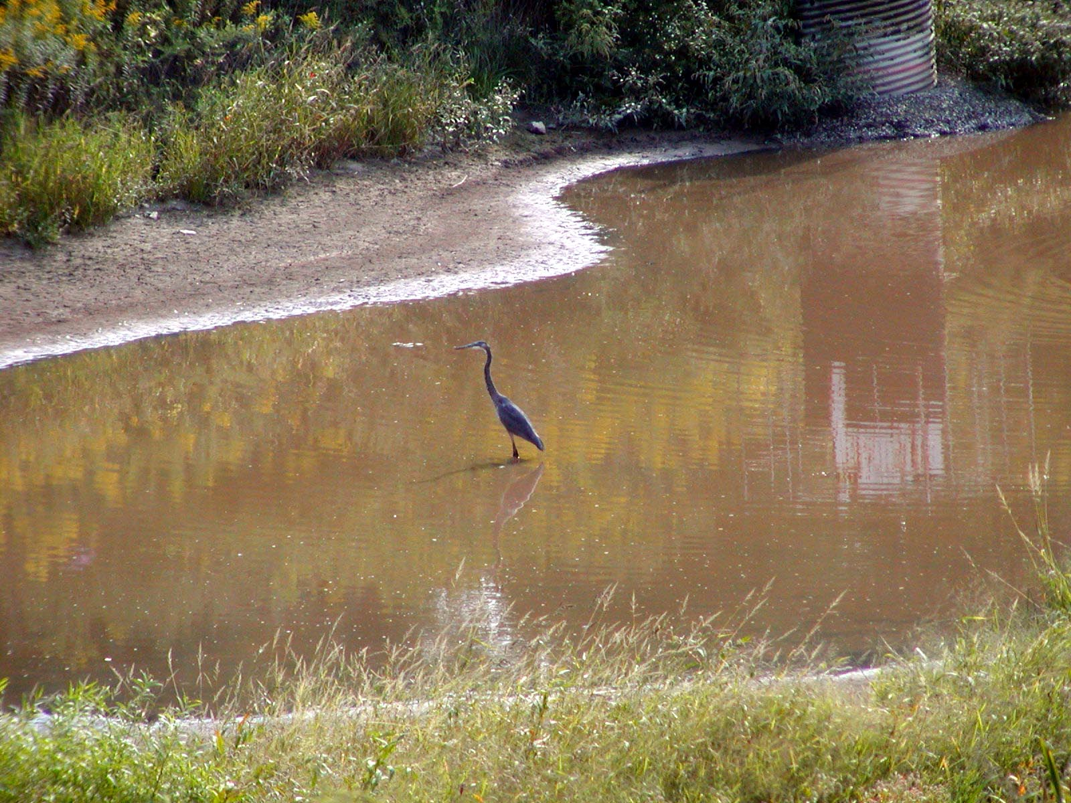
Notes:
One of our sedimentation ponds being visited by a Great Blue Heron.

Slide 46
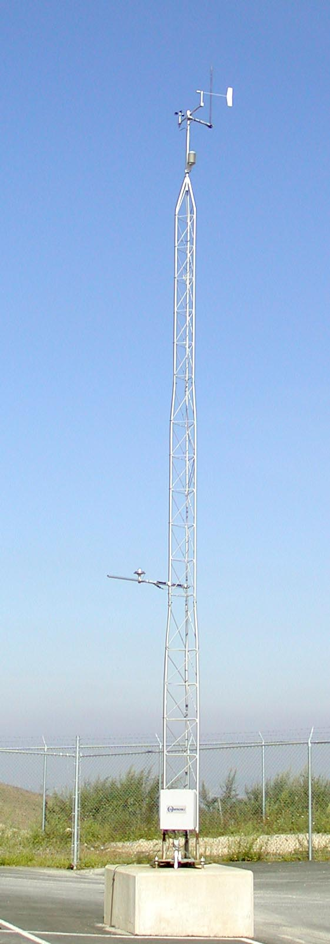
Notes:
Weather station by the Maintenance Building.

Slide 47
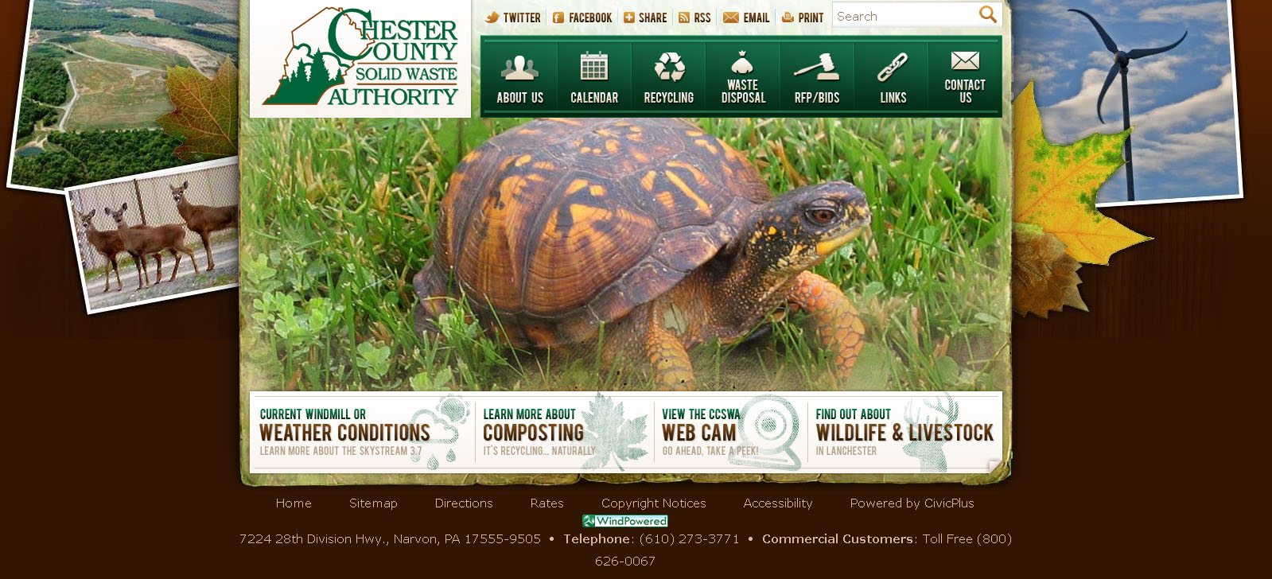
Notes:
Our Website www.chestercountyswa.org

Slide 48
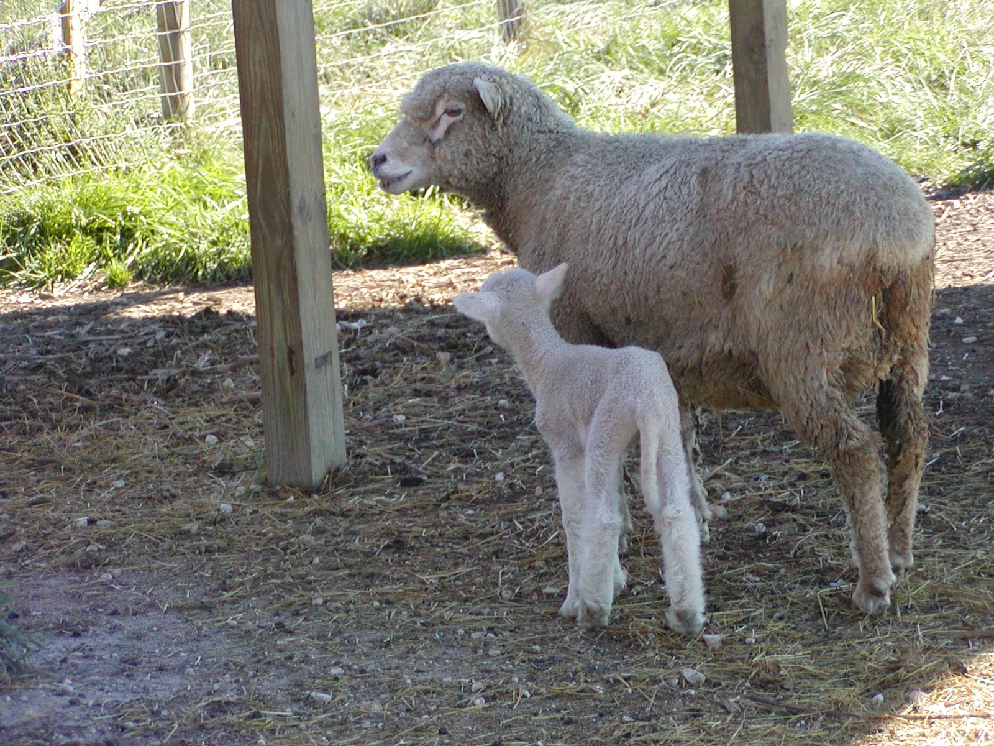
Notes:
We have had sheep and goats grazing on the landfill since 1999.

Slide 49
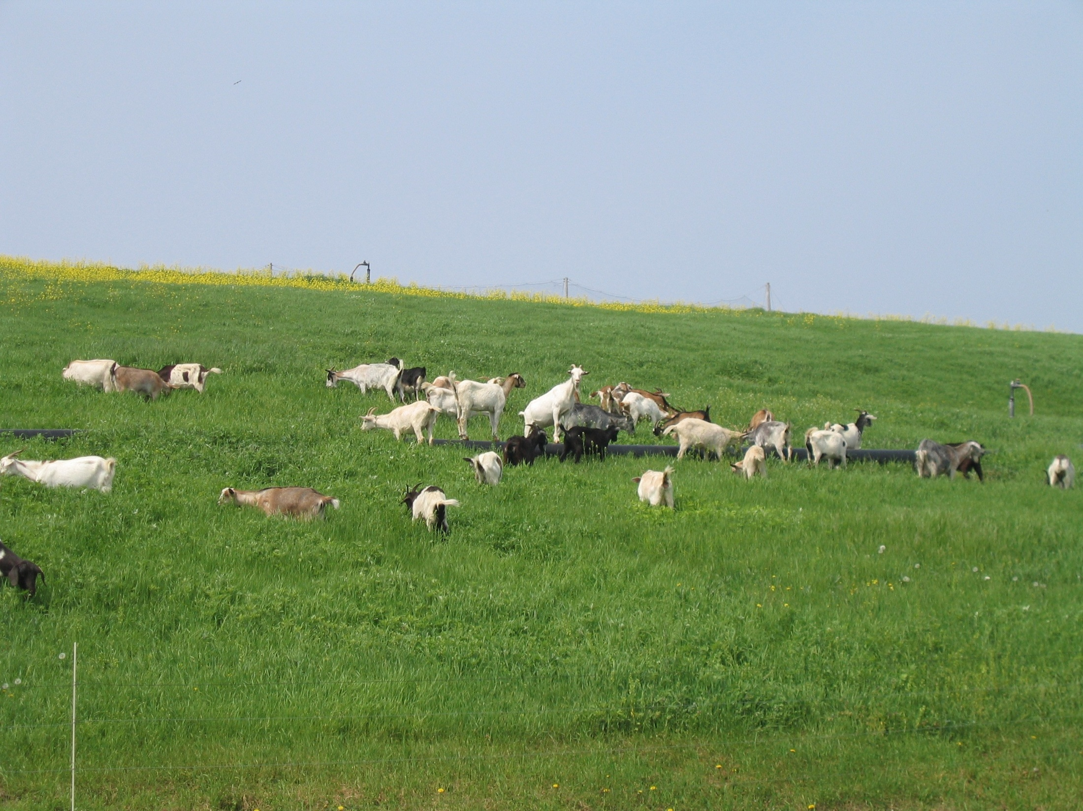
Notes:
Some of our goats.

Slide 50
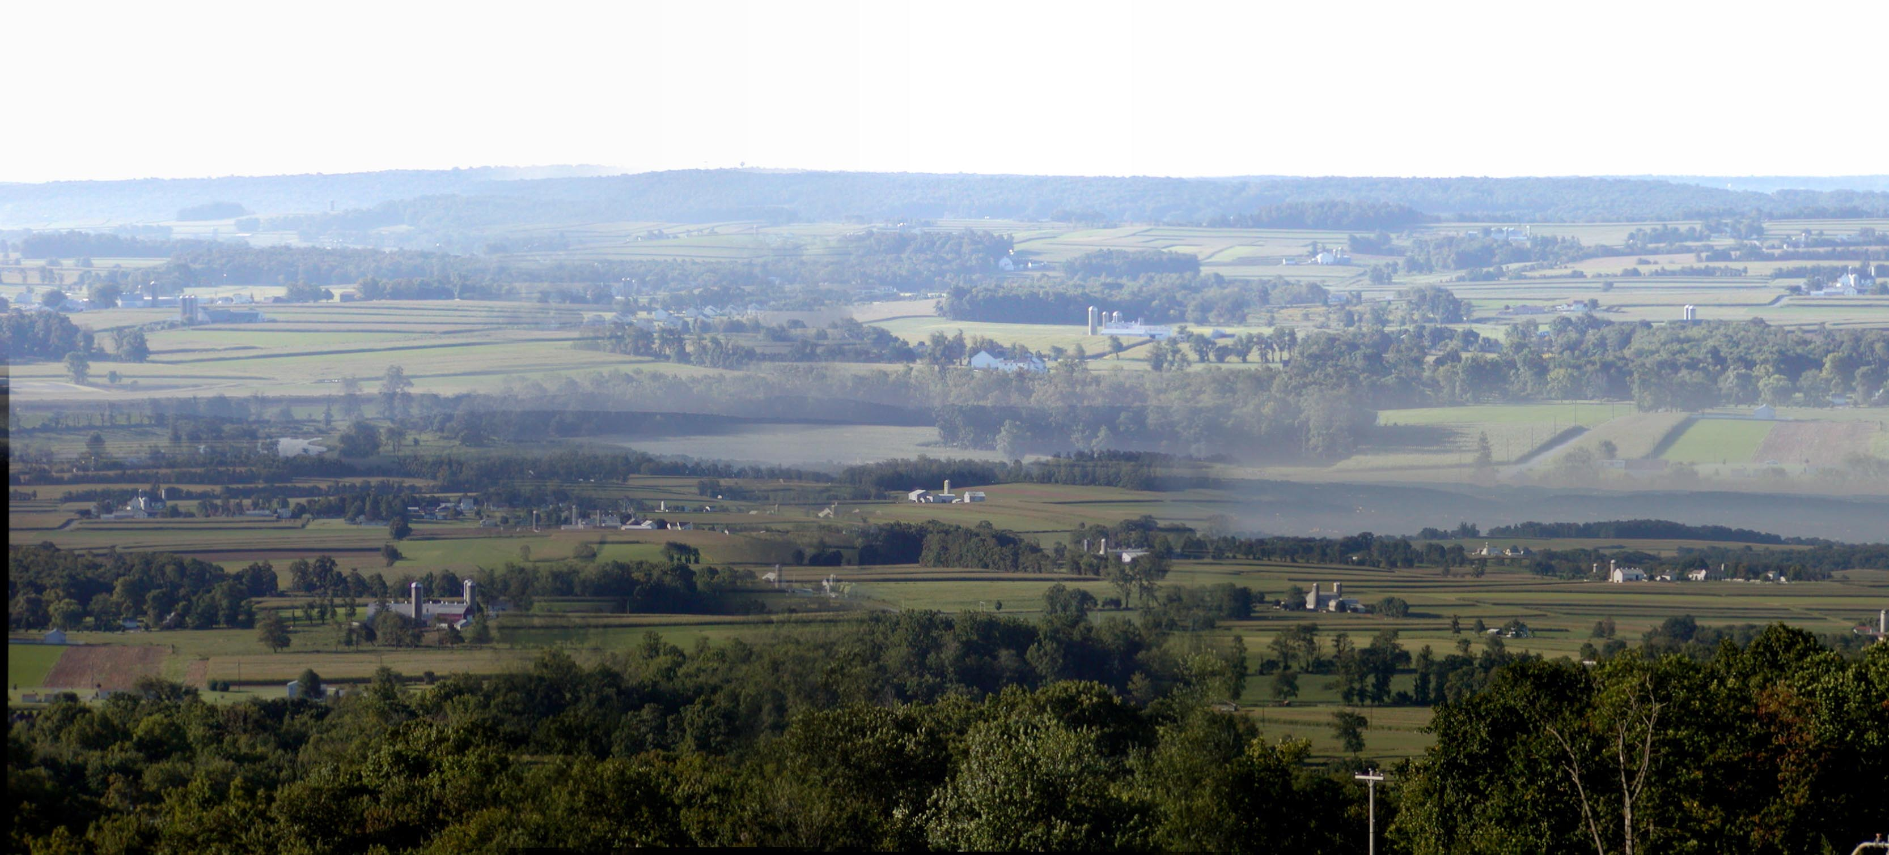
Notes:
View from the former Scenic Overlook

Slide 51
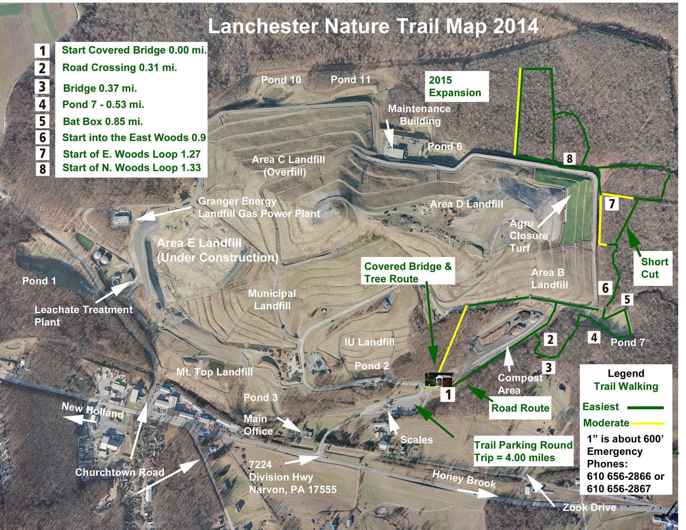
Notes:
Map of the Nature Trail 2014.

